Slide 1
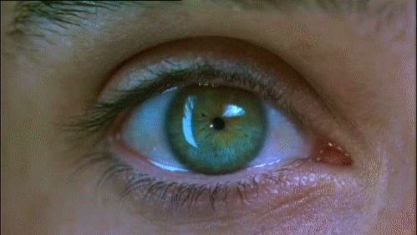
Substance use disorder
By: Syed Rizvi

Slide 2
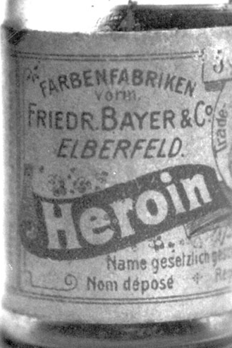
History
Use of substances are prevalent throughout our history.
Assyrians/Ancient Egyptians (opium)
Ancient Greece (mead- hallucinations)
New World (Tobacco crops)
Native American Cultures (peyote and psychedelics)
Rastafari religion (marijuana)
Notes:
from Assyrians and Ancient Egyptians cultivating opium from poppy seeds, to use of ‘mead’ in Ancient Greece to induce visions to tobacco crops in the New World which were a staple in the economy.
Shift from addiction as a purely criminal offense to an illness which could be managed; New York State Inebriate Asylum (1864) treated alcoholism as a mental health condition.

Slide 3
Societal influence
Linked to poverty, crime, race, culture and other factors. (War on Drugs)
Shift from ‘criminality’ to addiction as mental disorder (still happening).
https://www.youtube.com/watch?v=wJUXLqNHCaI
Results show legalization and decriminalization are not correlated with increased drug usage (Do Medical Marijuana Laws Increase Marijuana Use? Replication Study and Extension)
Notes:
Cocaine in coca-cola; harsher sentencing (mandatory minimums) for crack version of cocaine. Fair Sentencing Act still punishes crack abuses 18 x more powerfully than cocaine users. Marijuana associated with Latino Americans, and ‘anti-war hippies’ during Nixon; Schedule 1 drug despite having proven medical effects. Anti-Drug Abuse Acts sets mandatory minimums – possession of marijuana and nonviolent offenses can lead to a lifetime of imprisonment!
Opium associated with Chinese Americans working on the railroad

Slide 4
Thought break
Legalization and treatment for ALL drugs?
State-by-state basis?
Public health crisis which needs federal attention?

Slide 5
History of the DSm
First DSM (1952) conceptualized ‘substance use disorder’ (alcoholism and drug addiction were in a single category) as arising from a personality disorder.
New York State Inebriate Asylum (1864).
WHO and AMA (1965).
DSM II (1968) encouraged separate classifications for alcohol and drug addiction; three classifications for alcoholism.
Notes:
Shift from addiction as a purely criminal offense to an illness which could be managed; New York State Inebriate Asylum (1864) treated alcoholism as a mental health condition.
World Health Organization and American Medical Association declared alcoholism to be a medical disorder (1965).
a) episodic excessive drinking (intoxication four times per year); (b) habitual excessive drinking (given to alcoholic persons who become intoxicated more than 12 times a year or are recognizably under the influence of alcohol more than once a week and (c) alcohol addiction (defined in terms of dependency, suggested by withdrawal which may be evidenced by inability to abstain for one day or heavy drinking for three months or more)

Slide 6
History of the DSm (cont)
Starting in DSM-III (1980), the categories of Substance Abuse and Substance Dependence were adopted, use of diagnostic criteria and separated SUD (substance use disorder) apart from other mental health disorders.
DSM-IV (1994) clarified distinctions between substance dependence and physiological dependence (“with” and “without physiological dependence”)
Notes:
DSM-III-R eliminated Abuse category and broadened the Dependence category due to reliability/external validity issues and ‘diagnostic orphans’ (individuals with symptoms with no diagnosis)
DSM IV- Diagnosis without a Withdrawal/tolerance symptom; such that one can only be diagnosed with substance abuse in the absence of substance dependence.

Slide 7
Current classification
DSM-V (2013) measures severity on a scale: mild (2-3 symptoms), moderate (4-5 symptoms) and severe (6 or more symptoms).
Removal of substance abuse and dependence
Removal of legal problems criterion (poor fit with other criteria) and term ‘addiction’ due to negative connotation.
Addition of ‘craving’ criterion
Notes:
Also added Gambling Disorder, first behavioral addiction included.
Lots of diagnostic orphans due to the dual factor substance abuse approach; meeting two symptoms ONLY for the dependence portion does NOT warrant a diagnosis
craving is often associated with increased likelihood of relapse to alcohol/drug use, and therefore it is thought that managing craving may improve treatment outcome.

Slide 8
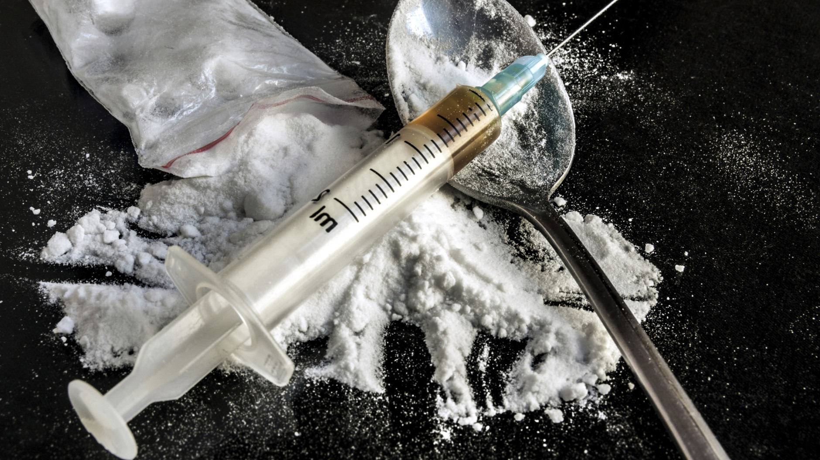
Classification
10 separate classes of drugs: alcohol;
caffeine; cannabis; hallucinogens (with separate categories for phencyclidine [or similarly acting arylcyclohexylamines] and other hallucinogens); inhalants; opioids;
sedatives, hypnotics, and anxiolytics; stimulants (amphetamine-type substances, cocaine,
and other stimulants); tobacco; and other (or unknown) substances. drugs of abuse directly activate the reward pathways.
Notes:
- The essential feature of a substance use disorder is a cluster of cognitive, behavioral, and physiological symptoms indicating that the individual continues using the substance despite significant substance-related problems.

Slide 9
Controlled substance act
Schedule 1: Lack of accepted safety for use, and high potential for abuse.
Schedule II: High potential for abuse with severe psychological/physical dependence.
Schedule III: Lower potential for abuse than 1 and 2, with moderate or low dependence.
Schedule IV: Low potential for abuse (relative to 3)
Schedule V: Lowest potential for abuse. (used for antitussive, antidiarrheal and analgesic purposes)
Notes:
Some examples of substances listed in Schedule I are: heroin, lysergic acid diethylamide (LSD), marijuana (cannabis), peyote, methaqualone, and 3,4-methylenedioxymethamphetamine (“Ecstasy”)
In 1970 the FDA released the following drug classifications, or drug schedules, under the Controlled Substance Act (CSA). The drug classificaton schedules organize drugs into groups based on risk of abuse or harm. Those drugs with high risk and no counterbalancing benefit are banned from medical practice and are Schedule I drugs.
Other Schedule II narcotics include: morphine, opium, and codeine, oxycodone, methadone, fentanyl
Schedule III: Vicodin, tylenon w/ codeine, suboxone, ketamine, anabolic steroids, Didrex
Schedule 4: Xanax, Soma, Klonpin, Valium, temazepam
Schedule 5: 100

Slide 10
GUESS THAT SYMPTOM (Or Film/tv show)!
Chocolates for anyone who can identify the symptom that is most closely associated with picture/gif!!

Slide 11
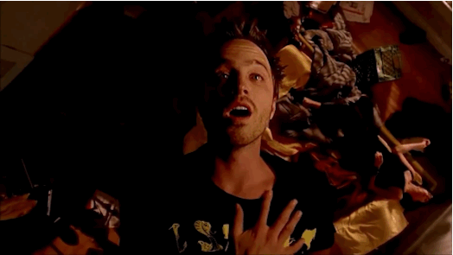
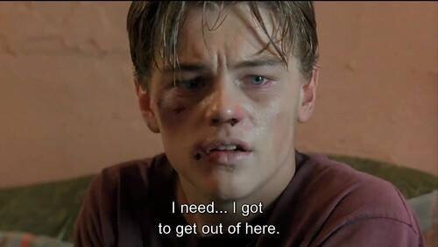
Diagnostic considerations
Criterion A criteria can be considered to fit within overall groupings of impaired control, social impairment, risky use, and pharmacological criteria.
1) 2)
Notes:
The individual may take the substance in larger amounts or over a longer period than was originally intended (Criterion 1)
The individual may express a persistent desire to cut down or regulate substance use and may report multiple unsuccessful efforts to decrease or discontinue use (Criterion 2).

Slide 12
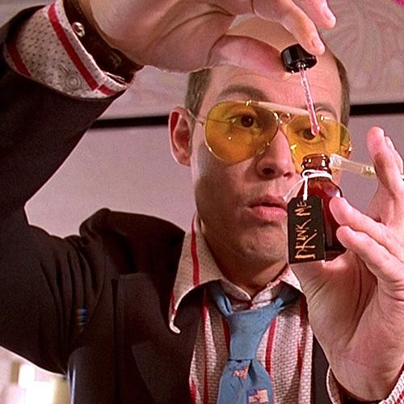
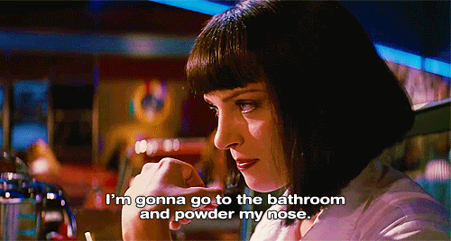
Impaired control
3) 4)
Notes:
The individual may spend a great deal of time obtaining the substance, using the substance, or recovering from its effects (Criterion 3).
Craving (Criterion 4) is manifested by an intense desire or urge for the drug that may occur at any time but is more likely when in an environment where the drug previously was obtained or used. Craving has also been shown to involve classical conditioning and is associated with activation of specific reward structures in the brain.

Slide 13
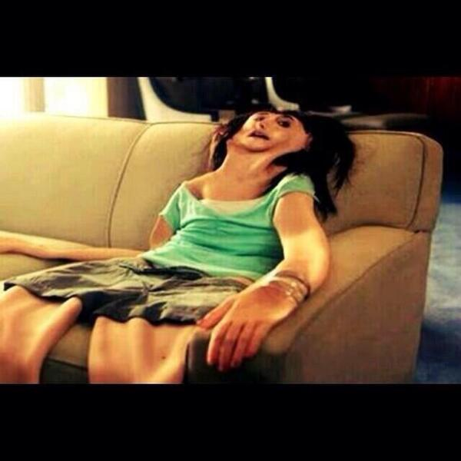
Social Impairment
5)
7)
6)
Notes:
Social impairment is the second grouping of criteria (Criteria 5–7). Recurrent substance use may result in a failure to fulfill major role obligations at work, school, or home (Criterion 5).
The individual may continue substance use despite having persistent or recurrent social or interpersonal problems caused or exacerbated by the effects of the substance (Criterion 6).
Important social, occupational, or recreational activities may be given up or reduced because of substance use (Criterion 7).

Slide 14
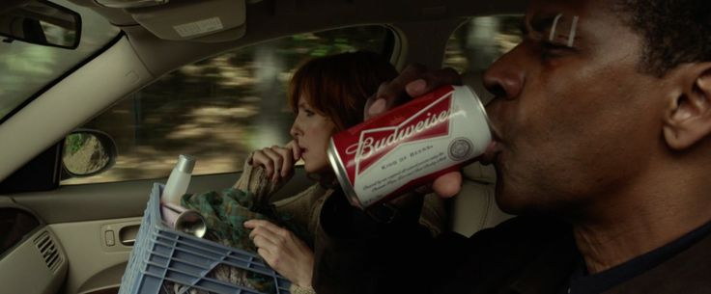
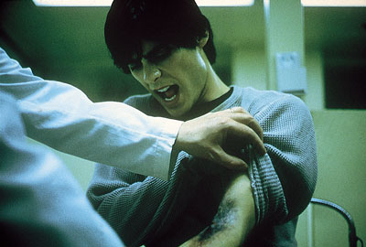
Risky Use
8) 9)
Notes:
Risky use of the substance is the third grouping of criteria (Criteria 8–9). This may take the form of recurrent substance use in situations in which it is physically hazardous (Criterion 8).
The individual may continue substance use despite knowledge of having a persistent or recurrent physical or psychological problem that is likely to have been caused or exacerbated by the substance (Criterion 9).

Slide 15
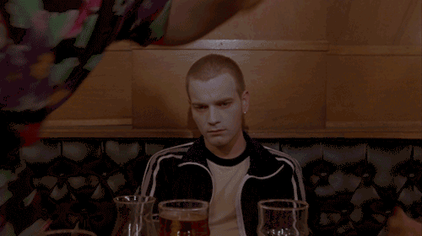
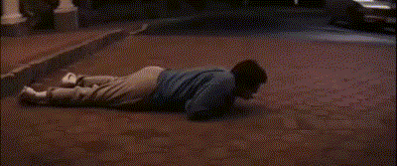
Pharmacological criteria
10) 11)
Notes:
Pharmacological criteria are the final grouping (Criteria 10 and 11). Tolerance (Criterion 10) is signaled by requiring a markedly increased dose of the substance to achieve the desired effect or a markedly reduced effect when the usual dose is consumed.
Withdrawal (Criterion 11) is a syndrome that occurs when blood or tissue concentrations of a substance decline in an individual who had maintained prolonged heavy use of the substance

Slide 16
Developmental course
“Individuals ages 18–24 years have relatively high prevalence rates for the use of virtually every substance. Intoxication is usually the initial substance-related disorder and often begins in the teens. Withdrawal can occur at any age as long as the relevant drug has been taken in sufficient doses over an extended period of time.” (p. 487)

Slide 17
Developmental course
Alcohol Use Disorder – “The large majority of individuals who develop alcohol-related disorders do so by their late 30s.” (p. 493)
Cannabis use disorder among preteens, adolescents, and young adults is typically expressed as excessive use with peers that is a component of a pattern of other delinquent behaviors usually associated with conduct problems.
High likelihood of school-related problems including truancy and drop in grades.
Notes:
Characterized by periods of remission and relapse, A decision to stop drinking, often in response to a crisis, is likely to be followed by a period of weeks or more of abstinence, with a period of controlled drinking and a high likelihood of return to severe problems.
Severe, repeated alcohol intoxication may also suppress immune mechanisms and predispose individuals to infections and increase the risk for cancers

Slide 18
Developmental course
Stimulant Use Disorder – “Binges involve continuous high-dose use over hours or days and are often associated with physical dependence. Binges usually terminate only when stimulant supplies are depleted or exhaustion ensues.” (p. 565)
Opioid Use Disorder - Even though relapses do occur, and while some long-term mortality rates may be as high as 2% per year, about 20%–30% of individuals with opioid use disorder achieve long-term abstinence.
Many other disorders including caffeine, Hallucinogen Use, Phencycledine (PCP), Inhalant Use (glues, and paints), and Sedative/Hypnotics (benzodiazepines)
Notes:
Stimulant smoking and intravenous use are associated with rapid progression to severe-level stimulant use disorder.

Slide 19
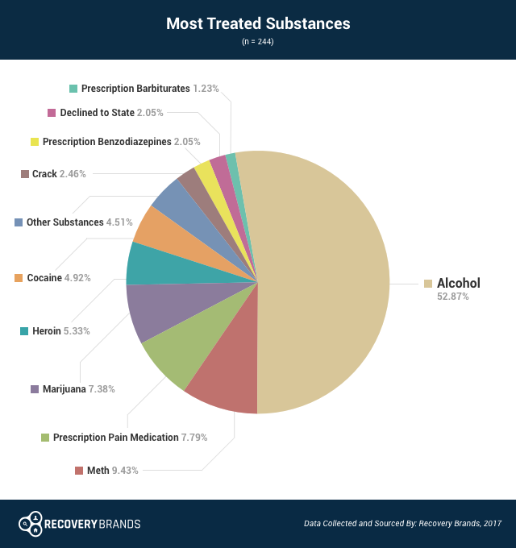
Life Course
Adolescents- poly drug use (alcohol & prescriptions), higher rates of academic failure, risky sexual behavior, negative interactions with parents, deviant behavior, etc.
‘Maturing out’ of drug usage is common (maturation of cognitive control areas)
Very early drug usage predicts later drug usage (National Center on Addiction and Substance Abuse)
Notes:
“maturing out” of substance use and SUDs, given that substance use is incompatible
with the demands of the roles of worker, spouse, and parent
Nine out of 10 people who meet the clinical criteria for substance use disorders involving nicotine, alcohol or other drugs began smoking, drinking or using other drugs before they turned 18. People who begin using any addictive substance before age 15 are six and a half times as likely to develop a substance use disorder as those who delay use until age 21 or older. (National Center on Addiction and Substance Abuse)

Slide 20
Thought break
Why is adolescence/young adulthood positively correlated with substance abuse?
Notes:
Low cognitive control and executive functioning, small ecological environment (peer influence), wanting to ‘try’ it out is ingrained in our culture (80% of 12th graders said it would be very easy to attain marijuana as opposed to 37% of 8th graders – national survey), adolescents who believe drugs are easier to attain are more likely to be ‘past month users’
Adolescence is a period of rejecting authority figures and conventionality (music, celebrities, social media stars, etc.)

Slide 21
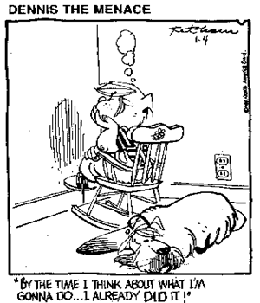
Risk factors
Temperament and personality (low ego control, aggression, impulsivity, negative affect, high perceived stress)
Poor executive functioning
High genetic risk if parents have SUD.
Poor parental support, single family households, divorced parents.
GxE interaction; higher risk environments such as peer influence, ‘enabling’ settings (social image of ‘toughness’)
‘Macro’ level influences (high levels of population density and crime, lack of neighborhood strength and community)
Notes:
deficits in executive functioning make it difficult for children both to create strategic and
goal-oriented responses to environmental stimuli, and to use feedback to modify behavior in response to environmental events
Peer influence: For example, older siblings’ drug use during adolescence and early adulthood has been found to prospectively predict younger siblings’ use
higher levels of harsh parenting (Brody & Ge, 2001) and family conflict have been found to be associated with higher levels of adolescent substance use and SUDs
National Council on Drug Abuse – poverty is linked with drug abuse; drugs and alcohol are easily attainable in ghettos (‘selling drugs’ to get out of poverty), BIGGEST thing is access to appropriate health services

Slide 22
Prevalence
20.1% of 8th graders and 49.9% of 12th graders had used some illegal drug in their lifetimes.
Marijuana
Drinking and smoking very common
Increase of stimulant drugs (Oxy, Vicodin, Ecstasy, Adderall), decline of cocaine, LSD, methamphetamine in adolescents.
‘Generational forgetting’
Alcohol abuse, cannabis use, hallucinogens, etc. greatest among individuals 18-to 29-years-old (16.2% & 4.4%)
‘Emerging adulthood’
Notes:
The Monitoring the Future Study (MTF) began in 1975 as a school-based
survey of substance use among the nation’s high school seniors, and is administered annually to over 45,000 students
in 8th, 10th, and 12th grades in 435 schools nationwide
An estimated 16 million people in the United States have AUD and 630,000 adolscents (12-17) – National Institute on Alcohol Abuse

Slide 23
Co-morbidity
“Costello and colleagues (2003) found that at least half of adolescents with SUDs were also diagnosed with disruptive behavior disorders.” (CD, ADHD, ODD, antisocial personality disorder)
Depression, social anxiety, and generalized anxiety are related to the onset of adolescent substance use.
Posttraumatic stress disorder (PTSD) symptoms have been linked to increased risk for drug usage.
Notes:
Severe, repeated alcohol intoxication may also suppress immune mechanisms and predispose individuals to infections and increase the risk for cancers
"Depressive disorders have an association with alcohol abuse or dependence and cannabis dependence. There are also reciprocal effects of suicidality and substance use. Mood disorders (including bipolar disorders — hypomania and mania) predict increased rates for cannabis use and cannabis use disorder.
Drug abuse may bring about symptoms of another mental illness. Increased risk of psychosis in vulnerable marijuana users suggests this possibility.
Mental disorders can lead to drug abuse, possibly as a means of “self-medication.” Patients suffering from anxiety or depression may rely on alcohol, tobacco, and other drugs to temporarily alleviate their symptoms. AS well as overlapping genetic vulnerabilities and environmental triggers,

Slide 24
Disorders to rule out
Substance Induced Mental Disorders: develop in context of intoxication or withdrawal from drugs, whereas medication-induced Mental Disorders are seen with prescribed or over-the-counter drugs.
Symptom profiles can be identical to independent mental disorders (hallucinations, delusions, psychoses, etc.) with the caveat that these are likely to improve after abstinence from substance in a matter of days or weeks.
Notes:
Generally true in most cases, but if drug abuse ‘triggered’ a mental disorder (large quantities of LSD for instance may activate periods of psychosis); therapy or medication may be needed
The clinically significant problematic behavioral or psychological changes associated with intoxication (e.g., belligerence, mood lability, impaired judgment) are attributable to the physiological effects of the substance on the central nervous system and develop during or shortly after use of the substance (Criterion B). The symptoms are not attributable to another medical condition and are not better explained by another mental disorder (Criterion D).

Slide 25
Disorders to rule out (cont)
The more sedating drugs (sedative, hypnotics, or anxiolytics, and alcohol) can produce prominent and clinically significant depressive disorders during intoxication, while impairment conditions (anxiety/panic)are likely to be observed during withdrawal syndromes from these substances.
Stimulants produce more anxious, aggressive, oppositional, or even paranoid affects (ODD, CD, emotional disturbance).
Effects of Repeated Withdrawal from Alcohol on Recovery of Cognitive Impairment under Abstinence and Rate of Relapse (2010, Alcohol and Alcholism, 45)
Notes:
Results demonstrate that current long-term benzodiazepine use (i.e., greater than 1 year) significantly affects a number of cognitive domains: working memory, processing speed, divided attention, visuoconstruction (i.e, ability to organize spatial information and physically form a design), recent memory, and expressive language (i.e., verbal and nonverbal communication
Effects of Repeated Withdrawal from Alcohol on Recovery of Cognitive Impairment under Abstinence and Rate of Relapse
Cognitive impairments ‘repair’, patients who had two or fewer detoxes performed significantly better than patients who had more than two previous detoxifications. Higher age and higher number of detoxifications affect recovery of executive functioning.

Slide 26
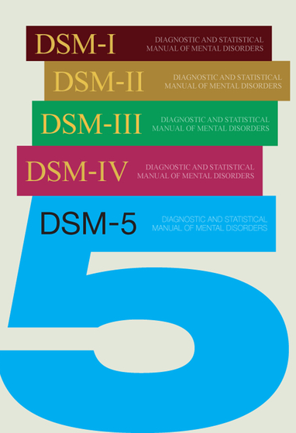
Assessment
Primary diagnosis should ALWAYS be made by trained professional!
Usually based on 11 symptoms of DSM.
Other screening tools such as the M3 Checklist for early detection, Alcohol Screening and Brief Intervention for Youth, AUDIT (Alcohol Use Disorders Identification Test)
Notes:
The number of diagnostic symptoms present defines the severity of the disorder, ranging from mild to severe (i.e., fewer than 2 symptoms = no disorder; 2 to 3 symptoms = mild disorder; 4 to 5 symptoms = moderate disorder; 6 or more symptoms = severe disorder.
CAGE and DAST-10 (Drug Abuse Screen Test) are meant for initial facilitation of treatment. Not as diagnostic instruments.

Slide 27
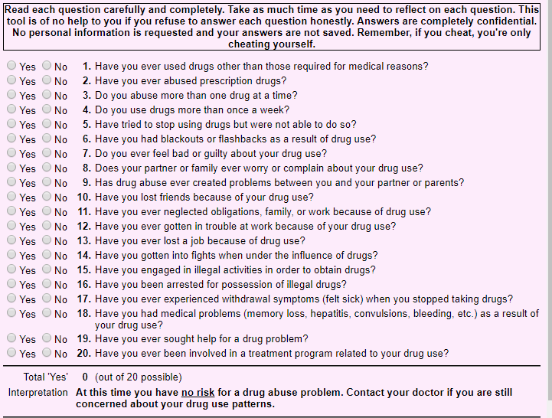
After a formal assessment, the information is discussed with the patient to jointly develop a personalized treatment plan designed to address the patient’s needs.
NOT a drug violation or arrest in this case.
For example: Someone with a severe substance abuse disorder
Notes:
The treatment plan and goals should be person-centered and include strength-based approaches, or ones that draw upon an individual’s strengths, resources, potential, and ability to recover, to keep the patient engaged in care.

Slide 28
Withdrawal
Cold-Turkey” detox
Short-term medicated detox
Long-term medicated detox
Long-term residential care in a medically managed withdrawal program.
LOTS of side effects; anxiety, nausea, muscle aches, insomnia, depression, violence, threat to self, hallucinations & cognitive impairment.
Notes:
Someone who experiences bone aches or muscle pains may be offered a pain reliever. Medical personnel who give patients these medications are standing by to make sure that they have what they need to get through the discomfort of detox as quickly as possible.
To treat use of opioid drugs such as heroin and prescription painkillers, patients might have the option to take longer-term medications. CONTRA-INDICATED; Do NOT go cold turkey!

Slide 29
Maintenance
1- to 3-month period of intensive rehabilitative care in a residential treatment program
Medically supported maintenance
Comprehensive Therapy (CBT, A multidisciplinary approach)
Family support
Notes:
Individual counseling often focuses on reducing or stopping substance use, skill building, adherence to a recovery plan, and social, family, and professional/educational outcomes. Group counseling is often used in addition to individual counseling to provide social reinforcement for pursuit of recovery.

Slide 30
Therapeutic community
TCs focus on the "resocialization" of the individual and use the program’s entire community—including other residents, staff, and the social context—as active components of treatment.
Long term model (6-12 months)
Transition back into life
Employment services
Notes:
Treatment is highly structured and can be confrontational at times, with activities designed to help residents examine damaging beliefs, self-concepts, and destructive patterns of behavior and adopt new, more harmonious and constructive ways to interact with others.
Using medication to treat substance use disorders is often referred to as Medication-Assisted Treatment (MAT).

Slide 31
Life goes on
Halfway houses or sober living houses
Outpatient treatment
Community-based programs (AA)
Success rate??
Notes:
1935: Dr. Bob Smith & Bill Wilson founded Alcoholics Anonymous (AA).
Alcoholics Anonymous has more than 115,000 groups throughout the world with over 2 million members.
A study conducted by AA in 2014 showed that 27 percent of the more than 6,000 who participated in the study were sober for less than a year. In addition, 24 percent of the participants were sober 1-5 years while 13 percent were sober 5-10 years. Fourteen percent of the participants were sober 10-20 years, and 22 percent were sober for 20 or more years.
National Institute on Alcohol Abuse & Alcoholism; Results revealed that those with alcohol issues who participated in both formal treatment and AA were more likely to be abstinent between years one and three. At the eight-year follow-up, those who participated in both treatments had a higher rate of abstinence.

Slide 32
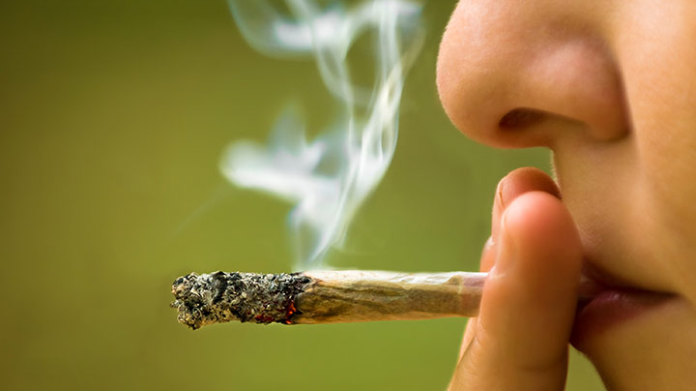
Education for adolescents
"Relief-oriented use of marijuana by teens," Journal of Substance Abuse Treatment, Prevention, and Policy
Youth were dealing with major events (divorce, death of family member, etc.) alongside the inherent challenges of adolescence.
Risky usage increases when young people attempt to deal with these situations in isolation.
Although marijuana, alcohol, MDMA, etc. may provide temporary relief, appropriate guidance and support from counselors, parents, teachers can benefit youth through education on stress management, coping skills, anger management, sleep hygiene, study skills, etc.
Notes:
Although marijuana provided the youth with temporary relief, the underlying situation often went unattended – leading the teens into a regular pattern of use

Slide 33
Evidence-based treatment
A central element of CBT is anticipating likely problems and enhancing patients’ self-control by helping them develop effective coping strategies.
Exploring the positive and negative consequences of continued drug use
Self-monitoring to recognize cravings and situations
Developing strategies for coping with cravings and avoiding those high-risk situations.

Slide 34
contingency management (CM)
VBR – Voucher Based Reinforcement (token economy)
For example: Prize Incentives for drug-free urine samples
Prizes increase for consecutive clean samples
Reinforce positive behaviors such as abstinence.
“highly effective in increasing treatment retention” (drugabuse.gov)

Slide 35
Community Reinforcement Approach (CRA)
Patients attend one or two individual counseling sessions each week, where they focus on improving family relations
learn a variety of skills to minimize drug use
Receive vocational counseling
Develop new recreational activities and social networks.

Slide 36
Motivational Enhancement Therapy (MET)
Motivational interviewing principles
Help patient build their own plan for change.
Mixed results
Feedback session
Monitor change and cessation strategies
Review and strengthen abstinence lifestyle
Notes:
In general, MET seems to be more effective for engaging drug abusers in treatment than for producing changes in drug use.
Success with alcohol and marijuana WHEN combined with other forms of treatment (CBT for example)

Slide 37
Multisystemic Therapy (MST)
Addresses adolescents substance abuse and factors associated with it.
Family (conflict, parental drug abuse)
Peers (friends who engage in drugs)
Neighborhood (gang subculture)
School (Poor performance, academic help)

Slide 38
Multidimensional Family Therapy (MDFT)
Ecological mode – Adjusts behavior in network of influences.
Therapist work with adolescent on
Decision-making skills/negotiation
Communication skills
How to increase desirable behavior in various settings.
Parallel sessions with family members (parenting style)

Slide 39
Family Behavior Therapy (FBT)
Conduct disorder, depression, family conflict, and unemployment
Sessions are performed alongside a SO (parent for adolescent)
Contingency management system
Patients choose interventions and treatment planning.

Slide 40
Diagnostic controversies
Combining Alcohol Use and Alcohol Dependence from DSM-IV into a single category.
Critics say the revised criteria could lead to college or underage binge drinkers to be mislabeled as mild alcoholics, a diagnosis the could follow them into their later years.
A beginning drinker who may occasionally binge on the weekends would be classified in the same stage as a end-stage alcoholic.
Notes:
Issues of validity; meeting ‘criteria’ for a substance use disorder, does not warrant a diagnosis. NIMH (National Institute of Mental Health) drew its support of the manual two weeks before its publication due to the issue of ‘needless increase in diagnoses’.

Slide 41
Post by Former NIMH Director Thomas Insel: Transforming Diagnosis
“The weakness is its lack of validity. Unlike our definitions of ischemic heart disease, lymphoma, or AIDS, the DSM diagnoses are based on a consensus about clusters of clinical symptoms, not any objective laboratory measure. In the rest of medicine, this would be equivalent to creating diagnostic systems based on the nature of chest pain or the quality of fever. Indeed, symptom-based diagnosis, once common in other areas of medicine, has been largely replaced in the past half century as we have understood that symptoms alone rarely indicate the best choice of treatment.” (April 29, 2013).

Slide 42
Article discussion
LOTS of changes to DSM 5: could lead to qualitatively new diagnosis
Employed population-based twins (genetic influence across diagnostic criteria)
N = 1,910 twins from first collection and 5,544 twins from second collection (56% male)
Extensive series of interviews and given both DSM IV and DSM 5 diagnosis
Strengths and Limitations?
Notes:
First, this structure, which consists of 2 diagnoses (alcohol abuse [AA] and alcohol dependence [AD]), would be collapsed into a single construct, alcohol use disorder (AUD). Second, the AA criterion concerning legal problems (LP) would be removed. Third, a criterion addressing craving would be added
Is a DSM-5 diagnosis informative of familial risk to the same extent that a DSM-IV diagnosis does? Do the 2 diagnoses reflect the same underlying genetic liability or is the new diagnosis influenced by novel genetic factors?
Strengths: Identified important trait in familial aggregation, key validator in substance abuse, robust sample which looked at lifetime prevalence (instead of 12 month as past studies had), LOVE how they broke down the comorbid conditions most aligned with AUD, One benefit of the new guidelines is that individuals previously considered “diagnostic orphans”—those endorsing 2 dependence criteria but no abuse criteria—will be included in the new AUD diagnosis. LOTS of analysis and re-running of analysis to validate results (not a result of model structure)
Limitations- ‘Hazardous’ driving? Noted prevalence change when including ‘drunk driving’ but did not ask, indicate low prevalence due to craving omission. This leads to a biased AUD diagnosis as the rationale for a ‘craving’ addition was exactly to capture more diagnosis rates. Did NOT account for genetic differences despite having a large sample size to analyze. ONLY used Caucasian individuals.

Slide 43
ARTICLE DISCUSSION
“The proposed changes will not have a pronounced effect on lifetime prevalence rates, and the exclusion of the LP item is unlikely to reduce the sensitivity or accuracy of a DSM-5 diagnosis.”
Age of onset of AUD was older for D5.
Higher prevalence of cannabis use disorder.
Exclusion of LP factor does NOT affect changes in prevalence, however other studies found it was ‘the most consistent predictor of familial risk.’
Biometric analysis: genetic correlation and heritability of alcohol problems is captured by new diagnosis.
Notes:
BUT ‘study may have underestimated prevalence’ due to craving criterion.
the most commonly endorsed dependence criteria among these new cases were “loss of control” and “trying to cut down.” In addition, those endorsing only a single
abuse criterion (typically hazardous use), and who are presumed to have a low level of problems, will no longer be diagnosed with an alcohol problem

Slide 44
misconceptions
Jail time and punishment does NOT work in treating addiction.
Neither do Zero Tolerance Policies in schools
79% of people who spent time in prison were rearrested within five years. (State of Connecticut Department Correction)
Drug courts; intensive treatment, held accountable by Judge for not meeting obligations (hearing sentences, drug tests and reviews), rewards for doing well.
Low recidivism; felony re-arrest rate dropped from 40% to 12% in one county (L. Truitt, et al., 2002)
Notes:
Evaluating Treatment Drug Courts in Kansas City, Missouri and Pensacola, Florida: Final Reports for Phase I and Phase II, by L. Truitt et al., March 2002, NCJ 198477.
they are blind to the most basic distinctions between types of offenses. In many schools, dangerousness is irrelevant; the penalties are the same for weapons and alcohol, sale and possession, robbery, and disorderly offenses. Offenses that used to be resolved informally with an apology or an after-school detention now lead to formal disciplinary hearings. Second, they require a severe sanction, typically suspension or expulsion. Expediate the school to prison pipeline by making indiscretion formal through hearing and indictments.

Slide 45
Rapid detox
Sedation/chemically induced withdrawal
Weekend ‘cure’ and return to normal life; bogus.
Organ cleansing; remove ‘toxin’ drug chemicals.
Hypnosis; NO quick fixes
No conclusive results on treatment effectiveness.

Slide 46
My beliefs
“Except for pharmaceutical poison, there are essentially only two drugs that Western civilization tolerates: Caffeine from Monday to Friday to energize you enough to make you a productive member of society, and alcohol from Friday to Monday to keep you too stupid to figure out the prison that you are living in.”
- Bill Hicks
Empathy, understanding, help > Punishment, abuse, incarceration
What defines addiction?
https://www.maps.org/resources/papers
Notes:
But why are some drugs legal and some prohibited? Why do we arrest approximately 600,000 Americans each year for marijuana possession, but sell tobacco and alcohol on most corners? Why do we lock up people who use meth for years, and dole out the similar drug Ritalin to our children? It is not based on science and health harm, but most often because of racism, stigma, and who is perceived to be using the illegal drugs.
Founded in 1986, the Multidisciplinary Association for Psychedelic Studies (MAPS) is a 501(c)(3) non-profit research and educational organization that develops medical, legal, and cultural contexts for people to benefit from the careful uses of psychedelics and marijuana
https://www.youtube.com/watch?time_continue=145&v=lsAZXLV0pPk

