Slide 1
Depression
Syed Rizvi

Slide 2
Major Depressive
Disorder
◦Depressed mood*
◦Diminished interest or pleasure in activities*
◦Significant changes in weight or appetite
◦Insomnia or hypersomnia
◦Psychomotor agitation or retardation
◦Fatigue or loss of energy
◦Feelings of worthlessness or excessive or inappropriate guilt
◦Diminished ability to think or concentrate, or indecisiveness
◦Recurrent thoughts of death, suicidal ideation without a specific plan, or a suicide attempt or a specific plan for committing suicide.
Notes:
Two key features: depressed mood and loss of interests/pleasure. Developmentally, except more irritability in children and adolescents.
Also consider impact (causing clinically significant distress or impairment) & episode is not attributable to the physiological effects of a substance or to another medical condition.
-single or recurrent episode
- Severity
- specifiers

Slide 3
Prevalence & Consequences of Depression
Depression is…
leading disability in the US for ages 15-44
estimated to exceed an economic impact of $40 billion annually
more likely to occur in girls/women
adolescents and young adults (18-29) 3x higher prevalence rates than those over 60
more likely to occur (3-4x increased rate) when a parent has depression
Having depression can lead to…
chronic & severe stressors that impact relationships (negative family interactions & bullying)
changes in peer relationships and social withdrawal
decline in academic achievement and engagement in leisure activities
Suicide (3rd leading cause of death in adolescents and young adults)
Doubles the risk of heart disease.
Thapar et al. (2012)

Slide 4
Pathology of Major Depressive Disorder
Monoamine Hypothesis:
Abnormalities in the serotonergic and/or noradrenergic systems
Deficiencies in the monoamine neurotransmitters (dopamine, norepinephrine, and/or serotonin) cause depression.
Revised Monoamine Hypothesis:
Depression due to neural degeneration due to insufficient amounts of tropic or growth factor
That is, downregulation of monoamine neurons → further downregulation of BDNF (brain-derived neurotropic factor) → decrease in neuronal signaling and plasticity → cellular degeneration.
Ettinger (2017)
Notes:
depression. In the 1960s, researchers began to speculate that these neurotransmitter systems were involved in depression, since drugs that were effective in its treatment altered neurotransmitter
PLUS,
Monamine (single amine group in their molecular structure, see Figure 3.1)
Reserpine → blocks vesicular transport of monoamine neurotransmitters into synaptic vesicles. Left in the terminal buttons → leds to deplease of neurotransmitters.
BDNF - essential for expression of new receptors, cell maintenance, and cell survival!
BUT, this all tells us that depression is a neurological disease that may be reversible or partially reversible by pharmacotherapies!
Ettinger, R. H.. Psychopharmacology (p. 71). Taylor and Francis. Kindle Edition.

Slide 5
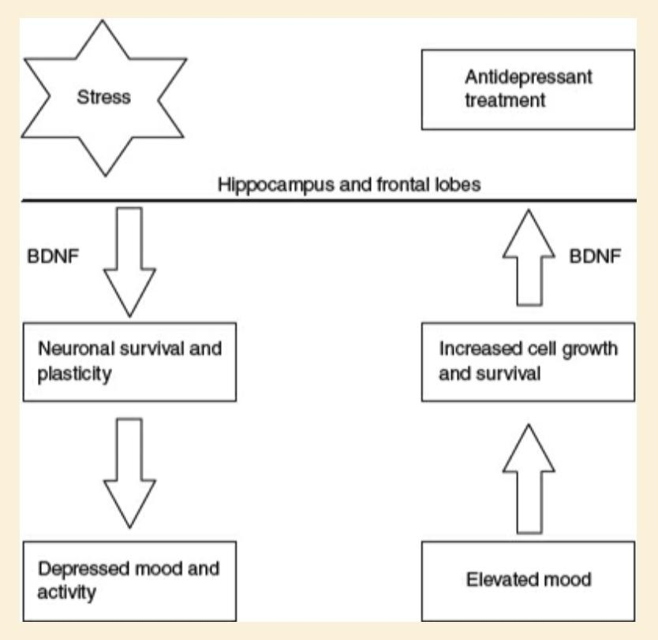
Stress→
Decreased norepinephrine and serotonin activity
Increased cortisol
Decreased BDNF (BDNF levels related to severity of depression)
Structural changes →
Decreased dendritic branches + Decreased cell growth = decreased volume
PFC, hippocampus, amygdala
Duman (2016)

Slide 6
History of Psychopharmacological Treatment
Amphetamine
“First antidepressant”
Serotonin Specific Reuptake Inhibitors (SSRIs)
Early work that lead to SSRIs began to develop a drug that was mood elevating effects and behavior stimulating!
Serotonin-Norepinephrine Reuptake Inhibitors (SNRIs)
1950s
1980s
2000s and beyond
1930s
1970s
1990s
Tricyclic Antidepressants
Monoamine Oxidase Inhibitors (MAOIs)
Mood-elevating and psychostimulant effects
First SSRI approved for tx of MDD
Fluoxetine (Prozac) finally approved 10 years after research first began
Major advancement in treatment!
Continued research on the mechanisms and treatments for depression
Atypical antidepressants
Notes:
Tricyclic antidepressants- pharmacokinetics Table 3.1 in book
Developmental consideration: SSRIs for 18-24 year olds have an increased risk of suicide ideation and suicidality. Above 24, no increased risk. Above 65 decreased risk for suicidality. But mixed reviews, bc prescriptions of SSRIs have decreased and completed suicides increased during this time.

Slide 7
Historical Overview of Drugs
Amphetamine in 1930s - Benzedrine marketed as ‘first antidepressant’ - used for soldiers during WWII.
Resperine for hypertensive vascular disease was found to inhibit monoamine transporters in 1950s.
The myth of reserpine-induced depression: role in the historical development of the monoamine hypothesis (Baumeister et al., 2003).
Development of antitubercular compounds; Fox & Gibas (1953) reported ‘side effects’ of euphoria, increased appetite/improved sleep in iproniazid (MAO).
Cheese Reaction
Dr. Kuhn discovers imipramine improved depression but not psychotic symptoms (tricyclic)
1970s - Fluoxetine developed as SSRI in America, Zimeldine in Europe.
Notes:
and as a result, depletes brain monoamines (i.e. serotonin and catecholamines), which provided evidence for the role of serotonin, norepinephrine, and dopamine in depression
Iproniazid - MAO inhibtor but taken off U.S. market due to ‘cheese reaction’ - high amounts of tyramine as found in dairy products would increase activity in sympathetic nervous system
Dr. Kuhn:
“They commence some activity of their own, again seeking contact with other people, they begin to entertain themselves, take part in the games, become more cheerful and are once again able to laugh…
The inhibitions of norepinephrine and serotonin reuptake at the transport proteins are thought to be responsible for the therapeutic effects of TCAs
SSRIs are 20-1500 fold more selective for inhibiting serotonin over norepinephrine at their respective transporter proteins

Slide 8
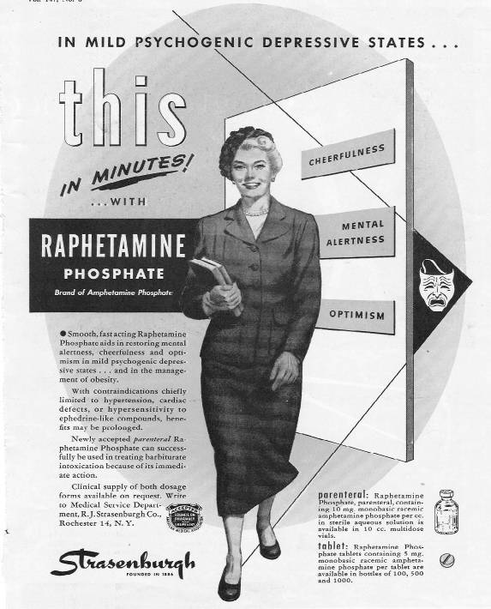
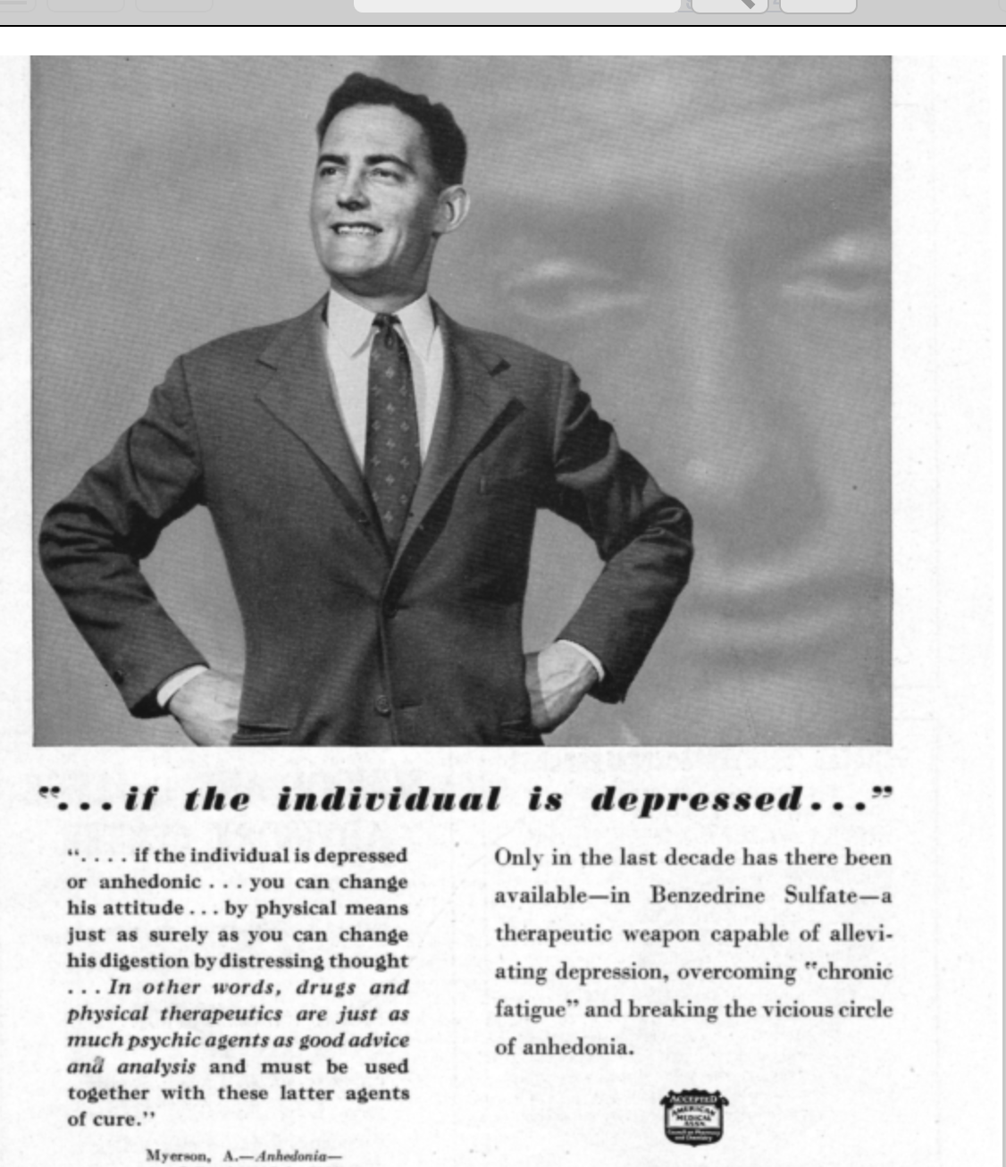

Slide 9
New Antidepressants
Bupropoin in 1980s - dopamine-norepinephrine reuptake inhibitor.
Venlafaxine in 1990s - serotonin-norepinephrine reuptake inhibitors (SNRI)
2013 - Vortioxetine marketed as ‘multi-modal’ drug due to high binding affinity for several serotonin receptors.
Shift towards revised monoamine hypothesis.
Ketamine - derivative of phencyclidine (Special K); affects glutamatergic system (NMDA & AMPHA)
Notes:
Additionally, bupropion displays minimal or no binding affinity for serotonin transporters and lowest risk of sexual dysfunction.
SNRIs are similar to TCAs in that SNRIs inhibit the reuptake of serotonin and norepinephrine at the serotonin and norepinephrine transporters, respectively. Unlike TCAs, SNRIs have minimal or no pharmacological action at adrenergic (α1, α2, and β), histamine (H1), muscarinic, dopamine, or postsynaptic serotonin receptors
Clinical trials have shown that vortioxetine may help improve cognitive functioning.
suggests that depleted monoamine concentrations may play more of a modulatory role to other neurobiological systems, rather than a major direct role in MDD
Ketamine is approximately 12 and 20-fold more selective for NMDA receptors as compared to serotonin

Slide 10
Brand Names
Resperine - mainly used for high blood pressure (serpex, serpazide, diuretic)
Iproniazid - Taken off U.S. market but still found (called Marsilid in France).
Imipramine - Tofranil; also used off-label to relieve chronic pain.
Fluoxetine - Prozac & Sarafem; can cause serotonin syndrome
Bupropoin - Alpenzin, Wellbutrin, Zyban, Buproban; also used for smoking cessation
Venlafaxine - Effexor; 51st most prescribed meditation in the U.S. (15 million)
Vortioxetine - Trintellix; improves cognition
Notes:
“We do not know exactly how vortioxetine mediates cognition, but it may be as a receptor antagonist at 5HT3 and 7, where it may impact neurotransmitters like glutamine and acetylcholine that are intimately involved in regulation of cognitive function,” said McIntyre - psychiatry advisor

Slide 11
Most common antidepressants
1 out of 6 Americans takes medication (12% of these are antidepressants)
Sertraline hydrochloride (Zoloft)
Citalopram hydrobromide (Celexa)
Fluoxetine hydrochloride (Prozac)
Trazodone hydrochloride (Desyrel)
Escitalopram oxalate (Lexapro)
Duloxetine hydrochloride (Cymbalta)

Slide 12
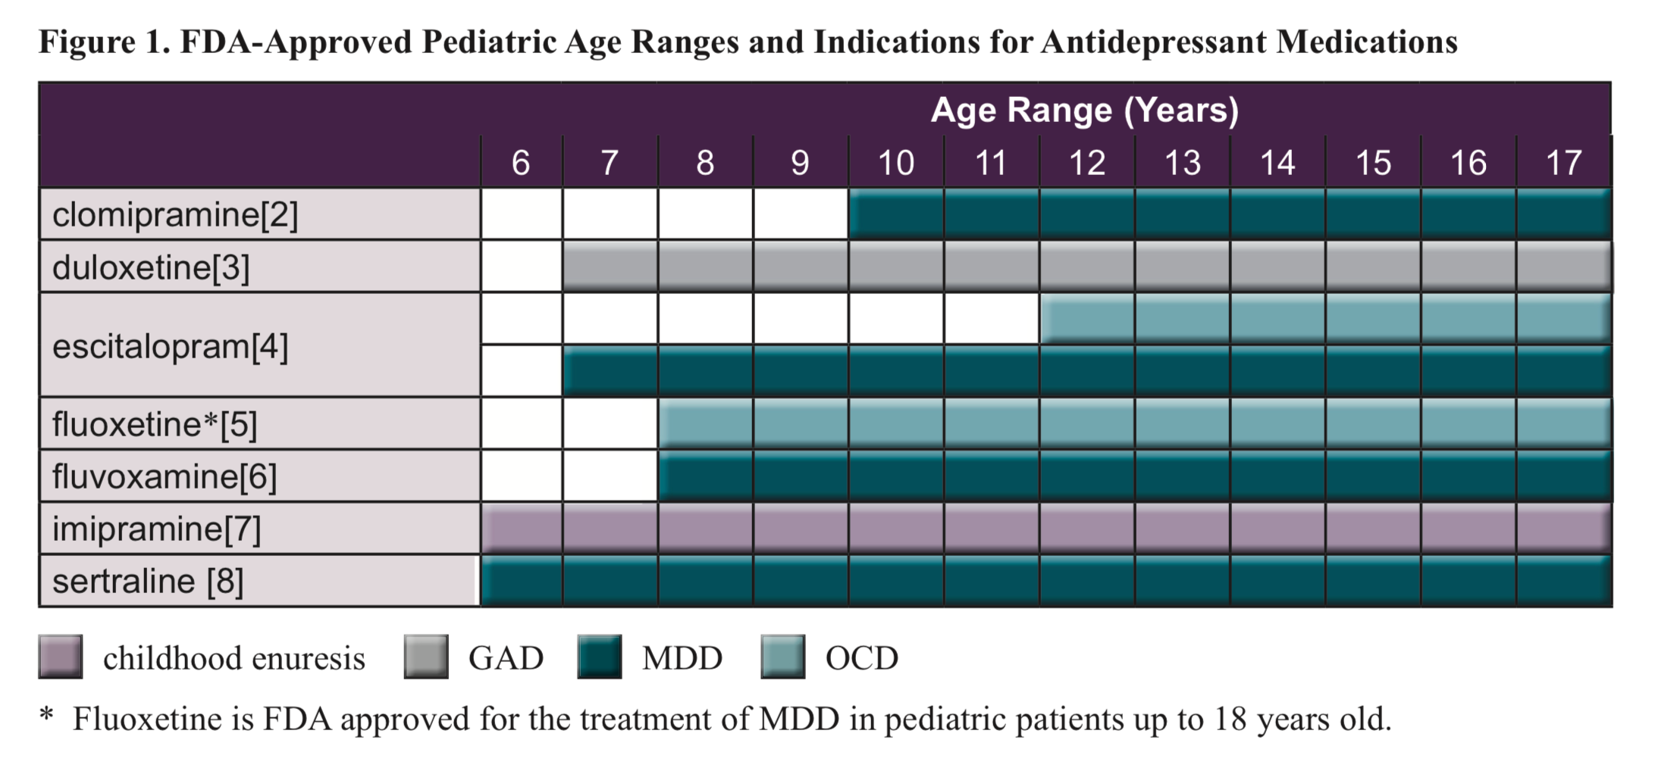
Notes:
Among the antidepressants, only Prozac is approved for use in treating MDD in pediatric patients. Prozac, Zoloft, Luvox, and Anafranil are approved for OCD in pediatric patients.

Slide 13
FDA Indications
(2004) - Increased risk of suicidality in adolescents; manufacturers must revise labeling with expanded warning statements on products.
Patient Medication Guide will be given to all patients which advises them on risk and precautions.
Boxed warnings:
Antidepressants increase the risk of suicidal thinking and behavior (suicidality) in children and adolescents with MDD and other psychiatric disorders.
Anyone considering the use of an antidepressant in a child or adolescent for any clinical use must balance the risk of increased suicidality with the clinical need.
Patients who are started on therapy should be observed closely for clinical worsening, suicidality, or unusual changes in behavior.
Families and caregivers should be advised to closely observe the patient and to communicate with the prescriber.
Notes:
https://www.fda.gov/drugs/postmarket-drug-safety-information-patients-and-providers/suicidality-children-and-adolescents-being-treated-antidepressant-medications
A total of 24 trials involving over 4400 patients were included. The analysis showed a greater risk of suicidality during the first few months of treatment in those receiving antidepressants. The average risk of such events on drug was 4%, twice the placebo risk of 2%

Slide 14
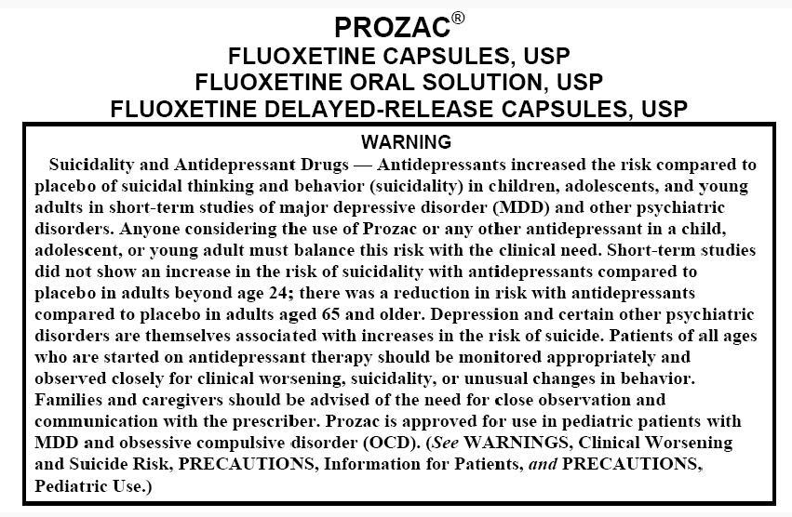

Slide 15
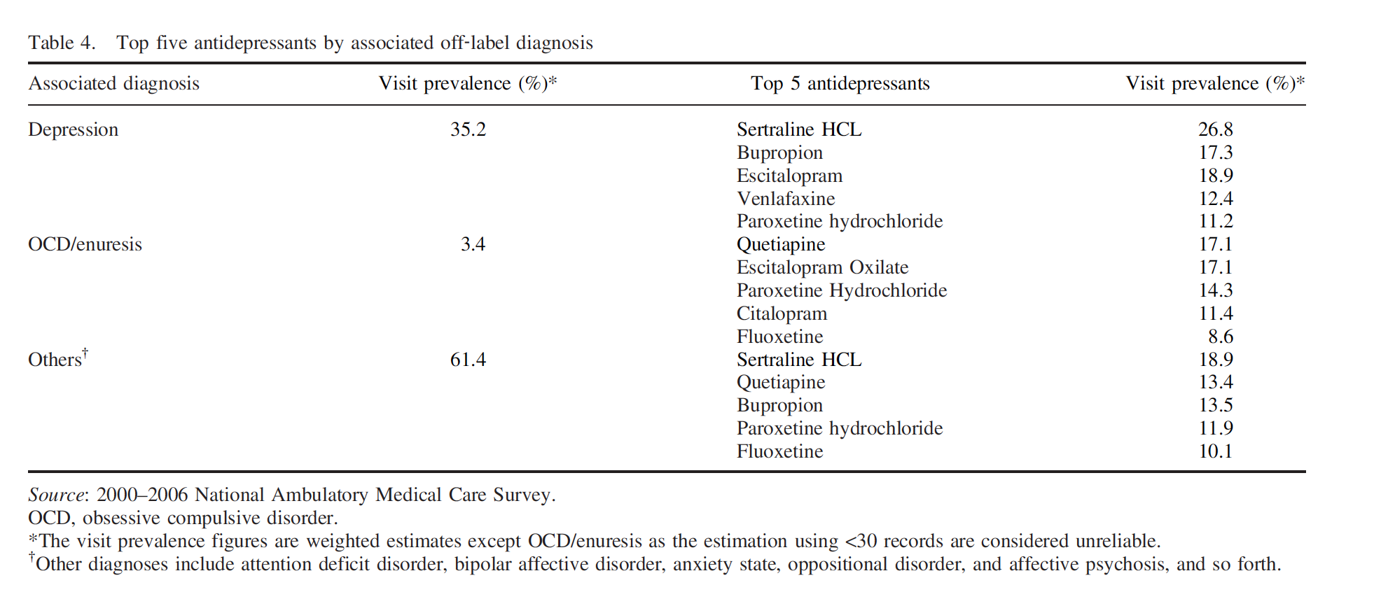
Off-Label Usage
Lee et al. (2012) Off‐label prescribing patterns of antidepressants in children and adolescents
Only 9.2% of visits (out of 18,646) from 2000-2006 were associated with FDA approved indications.
Pediatricians more likely to prescribe off-label than psychiatrists.

Slide 16
Mechanism of Action
Tricyclic - bind effectively to the reuptake transporter proteins for both norepinephrine and serotonin.
MAOIs - Deaminates monoamine oxidase neurotransmitters (norepinephrine, dopamine, and serotonin), irreversible consequences (banned in U.S.).
SSRIs - inhibit the reuptake of serotonin by competitively binding with the serotonin transporter protein. This competitive binding effectively blocks the reuptake of a significant amount of extracellular serotonin, leaving it available to engage pre- and postsynaptic receptor sites for longer durations.
SNRIs - Its mechanisms of action include blockade of the serotonin and norepinephrine reuptake transporters as well as the reuptake transporter for dopamine.
St. John’s Wort- Increases serotonin and norepinephrine by inhibiting the reuptake and vesicular storage of monoamine neurotransmitters so more are available in the synapse.

Slide 17
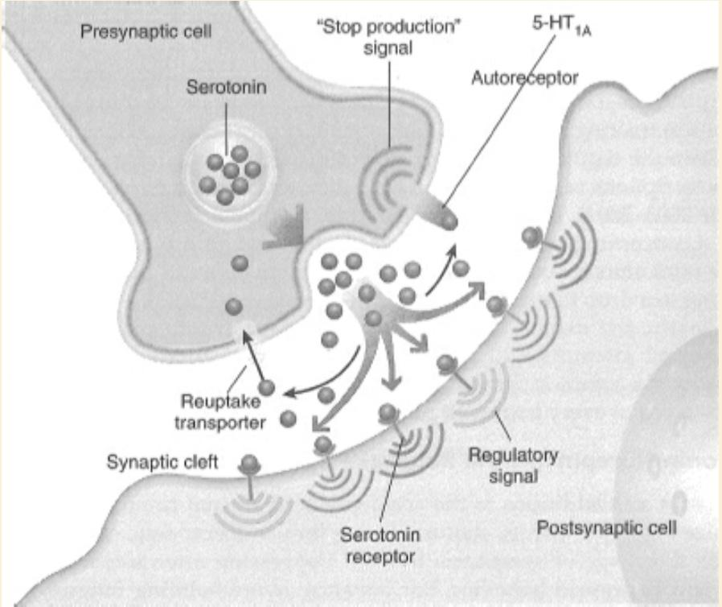
Mechanisms of Action of the Drug: Pharmacodynamics
*SSRI:
Block the reuptake transporter → serotonin in the synapse longer.
Increased serotonin → neuronal adaptions and downregulation of inhibitory 5-HT1A autoreceptors
Notes:
Symptoms of serotonin syndrome include disorientation, confusion, visual disturbances, severe agitation, mania, hypertension, hyperthermia, cold sweats, and diarrhea. In severe cases, serotonin syndrome can lead to a coma and perhaps death. This syndrome is most probable when SSRIs are taken with other medication that can increase serotonin activity, including all non-SSRI antidepressants
*Side effects of SSRIs:
Sexual dysfunction in males
Decreased libido
Gastrointestinal problems
Decreased appetite
Insomnia
Agitation
Serotonin syndrome
Ettinger, R. H.. Psychopharmacology (p. 81). Taylor and Francis. Kindle Edition.

Slide 18
Mechanisms of Action of the Drug: Pharmacodynamics
*SNRI:
Increased noradrenergic activity → enhancing activity of the reticular activating system
Block the reuptake transporter for serotonin and norepinephrine AND reuptake transporter for dopamine
Notes:
SNRIs- most recent addition to antidepressant pharmacological treatments. Developed in an attempt to minimize drug side effects, shorten lag time in therapeutic effectiveness, and increase the range of symptoms treated (i.e., depressed mood and depressed behavior!)
The mechanisms of SNRIs differ considerably in how they impact serotonin and norepinephrine neurons, and some increase dopamine activity.

Slide 19
Mechanisms of Action of the Drug: Pharmacokinetics
Absorption: Oral administration
Distribution: Pass through gastric system
Metabolism: Pass through liver
Excretion: Through kidneys
Notes:
These drugs differ only slightly in their molecular structure, and their mechanisms of antidepressant action are all essentially the same. They differ only in their relative specificities for different monoamine neurotransmitters and in their side effects on acetylcholine and histamine receptors.
Ettinger, R. H.. Psychopharmacology (p. 76). Taylor and Francis. Kindle Edition.

Slide 20
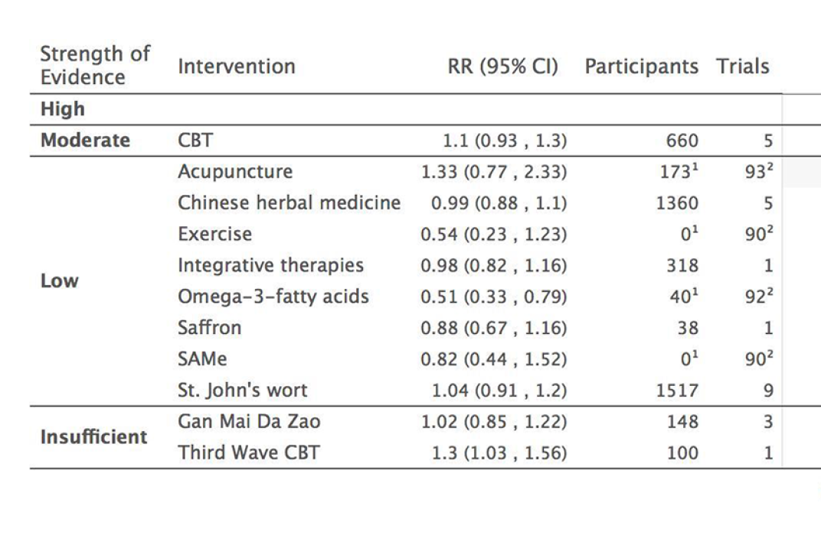
Pharmacological alternatives
Gartlehner et al. (2017) Pharmacological and nonpharmacological treatments for major depressive disorder: review of systematic reviews.
Out of 140 interventions; only CBT had general efficacy in comparison to second-generation antidepressants.
Lack of systematic review evidence for most other treatments.
Notes:
https://academic.oup.com/nutritionreviews/article/77/8/557/5499264
https://www.3rdwavetherapy.com/about/what-is-third-wave-cognitive-behavioral-therapy/

Slide 21
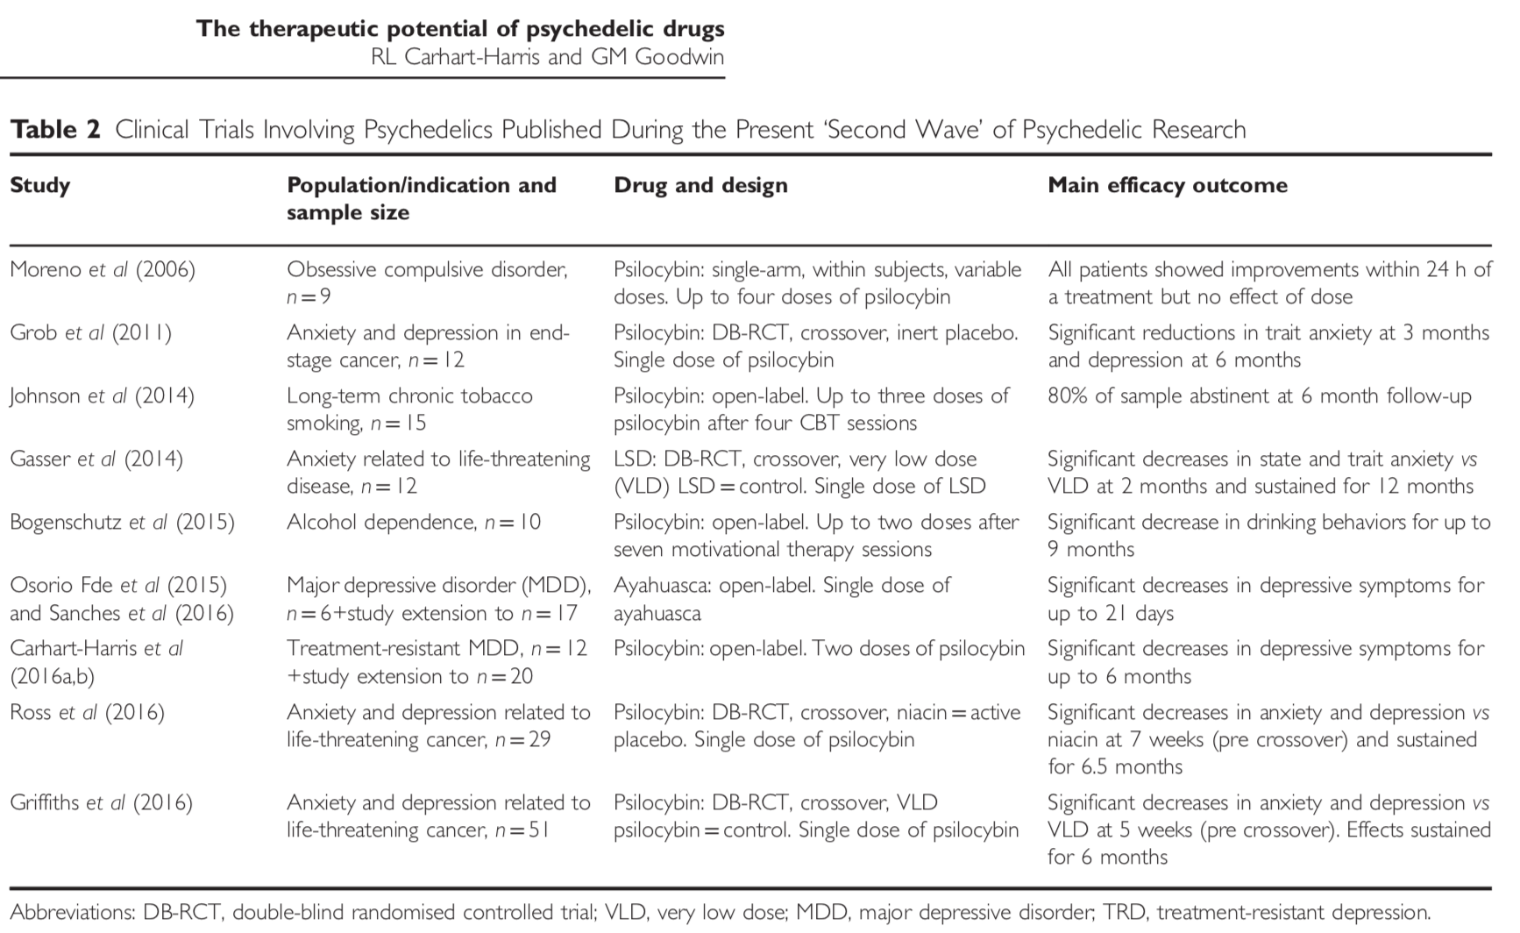
Notes:
https://www.youtube.com/watch?v=h7XBJoxWspE

Slide 22
Zhou et al. (2015) - Most effective psychotherapies
Zhou, X., Hetrick, S. E., Cuijpers, P., Qin, B., Barth, J., Whittington, C. J., ... & Zhang, Y. (2015). Comparative efficacy and acceptability of psychotherapies for depression in children and adolescents: A systematic review and network meta‐analysis. World psychiatry, 14(2), 207-222.
52 RCT studies (n = 3805) comparing 9 psychotherapies & 4 controls. (CBT, IPT, supportive therapy, cognitive therapy, family therapy, play therapy, behavioral therapy, problem-solving therapy, psychodynamic therapy).
IPT more significant at short-term and long-term than CBT (SMDs ranged from -0.78 to -1.08) and post-treatment (SUCRA = 90.5%) and follow-up (SUCRA = 90.3%)
Notes:
The SMD is the difference in mean change scores
from baseline to post-treatment between two groups divided
by the pooled standard deviation (SD) of the measurements,
with a negative SMD value indicating greater symptomatic
relief
The surface under the cumulative ranking curve (SUCRA) is a numeric presentation of the overall ranking and presents a single number associated with each treatment. SUCRA values range from 0 to 100%.

Slide 23
Side Effects
Top Google searches: “Will antidepressants change my personality?”
Risk of suicide in young people (no increased risk found in older adults).
Weight gain - Some evidence that bupropion (Wellbutrin) is less likely to cause weight gain than SSRIs.
Sleepiness/drowsiness - Mirtzapine (Remeron); some patients may need it.
One study found that over half of patients who take SSRIs report a sex-related symptom.
Nausea, fatigue, dry mouth, blurred vision, constipation, agitation, anxiety
Serotonin Syndrome - increased chances if SSRI is taken with another drug that enhances serotonin activity.
Notes:
Nausea, fatigue, dry mouth, blurred vision, constipation, agitation, anxiety - more pronounced with TCAs, less likely on SSRI

Slide 24
Monitoring/Treating Depression
Diagnostic understanding - Patient Health Questionnaire (PHQ-9), Children’s Depression Inventory (CDI-2), Symptoms of Depression Questionnaire (SDQ)- cut-off scores above threshold
Non-Pharmacological Treatments: Cognitive Behavioral Therapy (CBT; e.g., Coping with Depression-Adolescents) & Interpersonal Therapy for Adolescents (IPT-A)
Progress monitoring: Coping with Depression-Adolescent’s Mood & Activity Diary

Slide 25
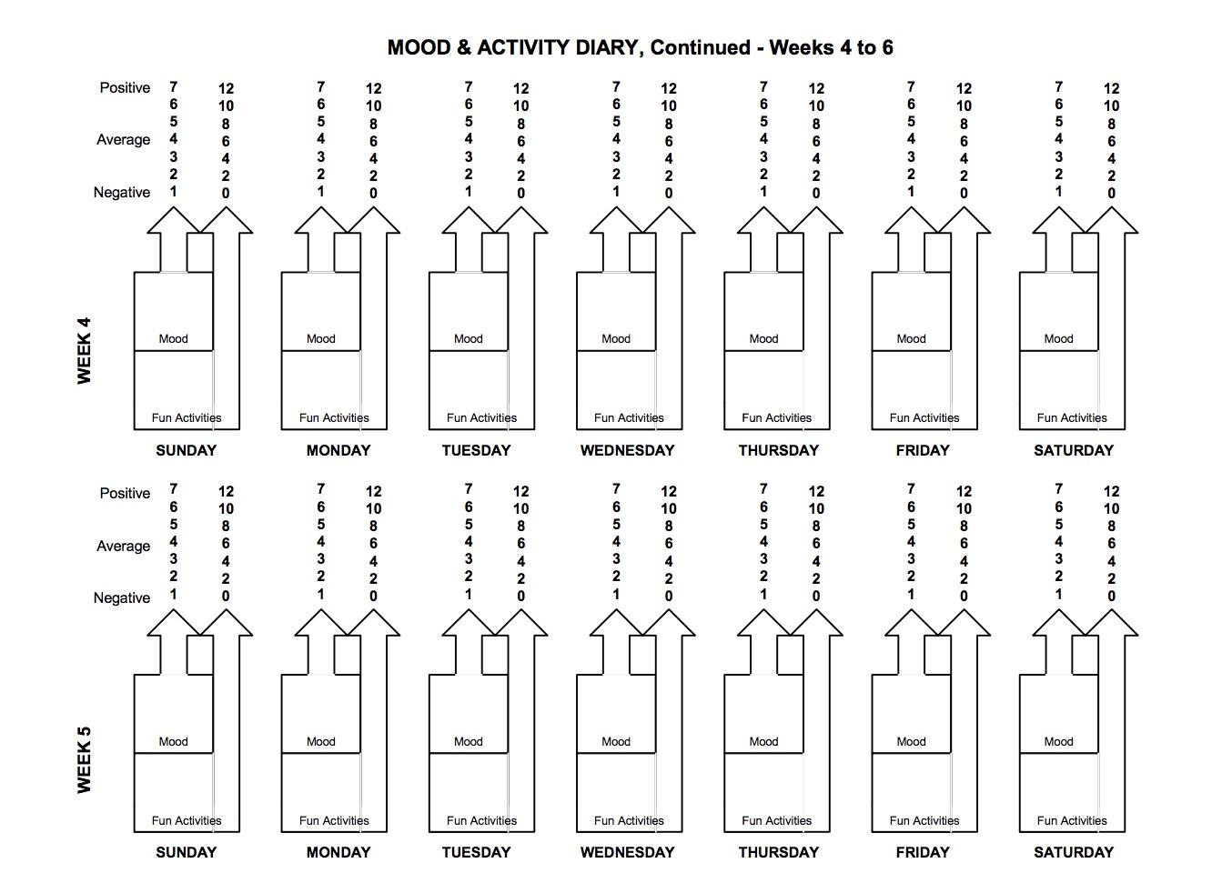
Mood & Activity Diary from Coping with Depression for Adolescents

Slide 26
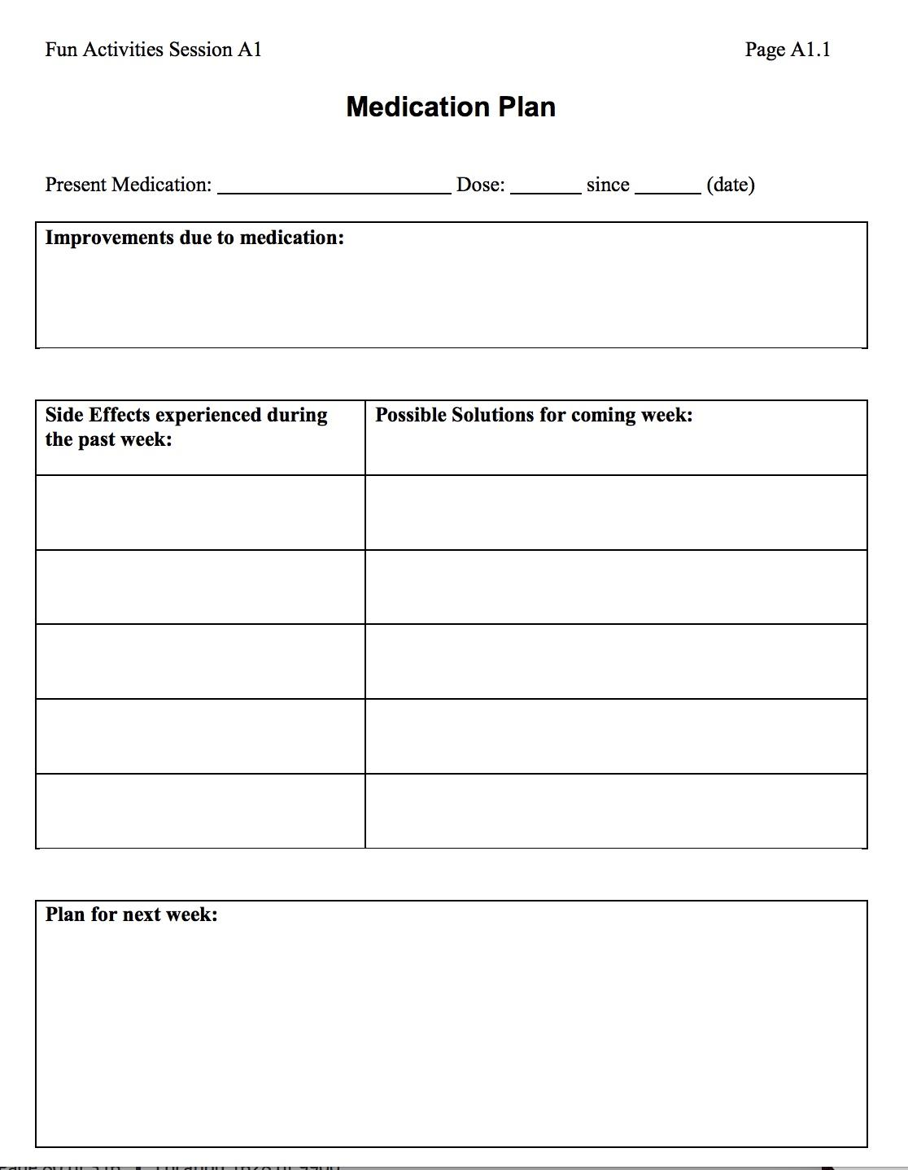
Medication Plan Worksheet from Coping with Depression for Adolescents

Slide 27
Prevention of Depression
Tier 1 - Early childhood interventions from early childcare particularly in lower SES communities.
Promoting well-being strategies as well!!!! :)
Tier 2 - CBT/IPT strategies for offspring of parents who have had depression, adolescents with subthreshold symptoms and adolescents who have had a previous depressive episode.
Tier 3 - Individual therapy/counseling and psychiatric assessment for adolescents who are diagnosed with MDD.
Notes:
Institute of Medicine. Preventing mental, emotional and behavioral disorders among young people: progress and Possibilities (2009);

Slide 28
Article Review
Cox, G. R., Callahan, P., Churchill, R., Hunot, V., Merry, S. N., Parker, A. G., & Hetrick, S. E. (2014). Psychological therapies versus antidepressant medication, alone and in combination for depression in children and adolescents. Cochrane Database of Systematic Reviews, (11).
11 studies (n = 1307)
Risk of bias - under ½ studies had adequate allocation concealment.
Limited evidence that antidepressant medication was more effective than psychotherapy (clinician defined remission) - 67.8% in medication group vs. 53.7% in psychotherapy group.
Limited evidence that combination therapy was more effective than antidepressant medication; 65.9% in combination vs. 57.8% in medication group.
Rates of suicidal ideation were significantly higher in medication group (18.6%) compared with therapy group (5.4%) - similar patterns from 6-9 month follow-up (13.6% vs. 3.9%)
Notes:
Allocation Concealment is a technique used to prevent selection bias in Randomised Controlled Trials (RCT's) by concealing the allocation sequence from those assigning participants to the intervention groups, until the moment of assignment.

Slide 29
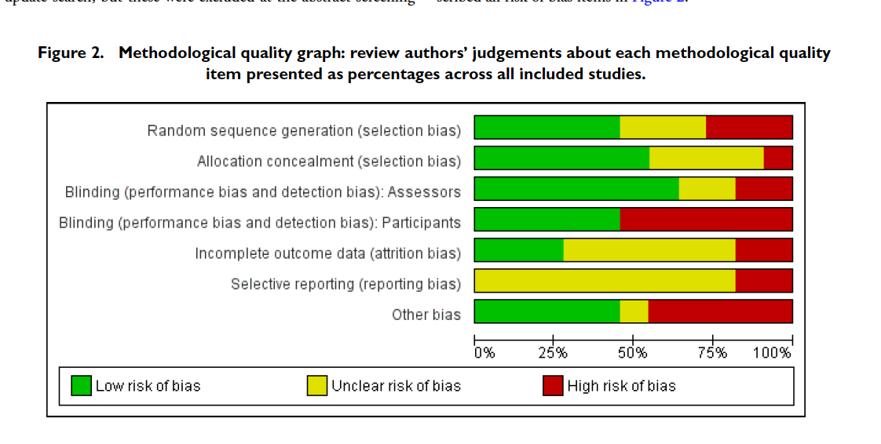
Article Review (cont).
CBT was grouped with BT, CT, PST, mindfulness training and 3rd wave therapies.
Thorough selection criteria; 3 review authors, had to be RCT, include participants with DSM or ICD criteria depressive disorder, at minimum compare an antidepressant with a psychological therapy.
Risk of bias assessed, assessment of heterogeneity, subgroup analysis (children/adolescents, severity), sensitivity analysis, tried to include international studies as well.
ITT - Intention to treat & OC - Observed cases
Notes:
Intention to treat (ITT) analysis means all patients who were enrolled and randomly allocated to treatment are included in the analysis and are analysed in the groups to which they were randomized.

Slide 30
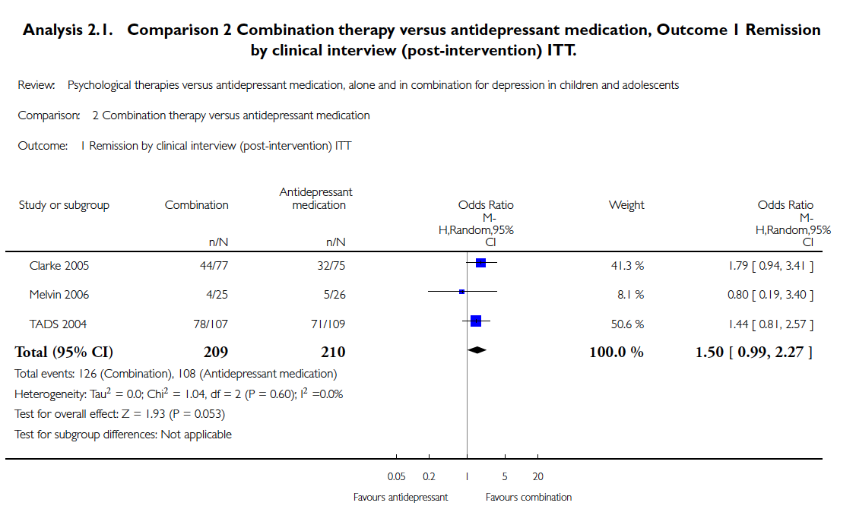
Article Review
TADS (2004) study showed that combination therapy was superior to medication alone but did not persist after follow-up (using clinician rating).
Clarke (2005) and TADS (2004) favoured combination therapy at 12-month follow-up (using self-reported depressive symptoms).
TADS (2004) found greater benefits for suicidal ideation with combination therapy.

Slide 31
Dubicka, B., Elvins, R., Roberts, C., Chick, G., Wilkinson, P., & Goodyer, I. M. (2010). Combined treatment with cognitive–behavioural therapy in adolescent depression: meta-analysis. The British Journal of Psychiatry, 197(6), 433-440.
Does CBT offer additional benefit to antidepressant treatment in adolescents?
Quality of trials were rated out of 27 (quality of description of randomisation; inclusion of data on participants who subsequently withdrew from the study (intention-to-treat); degree to which assessors of outcome were masked to treatment allocation; degree to which expectancy of participants about treatment was assessed; clarity of description of improvement; use of multiple informants to assess outcome; description of dosage regime; manualised therapy and assessment of therapy adherence; and assessment of adherence with medication.)
Mean rating score - 21 (all studies scored from 18-24 range).
1206 adolescents (mean age - 15)

Slide 32
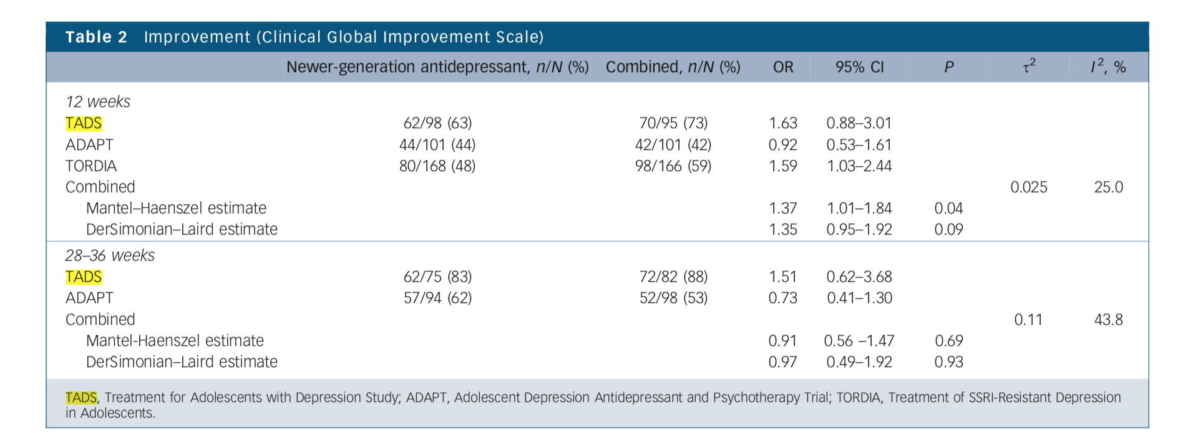
Combined treatment - most effective (mixed findings)
TADS - Treatment for Adolescents with Depression study (flouxetine w/ CBT vs. CBT) ADAPT - Adolescent Depression Antidepressant and Psychotherapy Trial (SSRI w/ CBT vs SSRI alone) TORDIA - Treatment of SSRI-Resistant Depression in Adolescents (alternate SSRI or venlafaxine vs SSRI w/ CBT)
Notes:
OR - odds ratio, OR >1 indicates increased occurrence of event
OR <1 indicates decreased occurrence of event
At 12 weeks, only TADS reported a significantly favourable benefit
for the combined arm over fluoxetine alone on continuous
measures of depressive symptoms,

