Slide 1
Bipolar Disorders
PHLS 8346 – Pediatric Psychopharmacology

Slide 2
Core Symptoms of Bipolar disorders
Core symptoms involve dysregulation of mood and energy.
Elevated mood and energy
Manic episode
Hypomanic episode
Depressed mood and energy
Major Depressive episode
Dysthymia
Notes:
Bipolar disorder is challenging to describe, due to its considerable heterogeneity. What does the clinical picture look like? Presentation runs the gamut from disinhibition and disorganization that are frankly psychotic, to periods of high energy associated with impetuousness but often large amounts of productivity, to episodes of severe and debilitating depression, as well as every permutation in between. Because of its episodic nature, it is also possible for a person to function within normal developmental limits during times of remission.
Manic episode: excessive elevation of mood, often with euphoria, extreme enthusiasm, and high energy. Very goal driven, with poor judgement, sometimes to the point of being psychotic with delusions and hallucinations.
Hypomanic episode: mood elevation, energy, and judgement may impair social and occupational functioning, but not always.
Treating BPD like MDD can be harmful by promoting manic symptoms, up to 30% diagnostic misdiagnosis.

Slide 3
History

Slide 4
DSM Changes
Pre DSM-III | DSM-III | DSM-III-R | DSM-IV → DSM-V
Manic depressive Insanity and Paranoia | Manic-Depressive → Bipolar Disorder | Subtypes: -mixed -manic -depressed -NOS -Cyclothymic | -Bipolar I -Bipolar II -Cyclothymic Disorder -Other Specified and Related Bipolar Disorders
 | First time distinguishing adults and children
Notes:
Prior to the 1990s, there was a smattering of published case reports. The 1990s ushered in a combination of research and popularization that made the diagnosis much more salient. The result was a dramatic rise in the rate of clinical diagnoses of PBD. The number of office visits billed under a diagnosis of a bipolar disorder rose 40-fold in the span of two decades (Moreno et al., 2007), and data from the (2014-08-01).
Centers for Disease Control and Prevention indicated that more than 50% of psychiatrically hospitalized children under the age of 12 carried clinical diagnoses of bipolar disorders by 2003 (Blader & Carlson, 2007).
It is still hotly debated whether these increases reflect corrections for past underdiagnosis, mislabeling of different entities as PBD, or a faddish overuse of what should be a rare diagnosis. Critics have raised the concern that the popularity of the PBD diagnosis might be influenced by pharmaceutical marketing or other extrinsic interests (Healy, 2006; Youngstrom, Van Meter, & Algorta, 2010). The debate has continued through the revisions to the DSM
The number of disorders DSM includes on the bipolar spectrum increased in DSM-III (APA, 1980), DSM-III-R (APA, 1987), and DSM-IV/ DSM-IV-TR (APA, 2000), although DSM-5 (APA, 2013) stays with the same set of definitions as DSM-IV. The current nosology includes diagnoses of bipolar I, bipolar II, cyclothymic disorder, and other specified bipolar and related disorder (OS-BRD). The OS-BRD category subsumes the same prototypes that DSM-IV included under “bipolar disorder not otherwise specified” (BP-NOS), as well as adding a prototype of “short-duration cyclothymia.” Both DSM-5 and DSM-IV also have designations for substance-induced manic symptoms and for manic symptoms due to another medical condition. (2014-08-01). Child Psychopathology, Third Edition (p. 3). Guilford Publications. Kindle Edition.
Now have DMDD to help reduce improper dx of PBD

Slide 5
Developmental Differences
Bipolar disorders → adult age range
Pediatric bipolar disorder (PBD)→ child and adolescent age range
Notes:
A bipolar disorder over the course of a lifetime is uncommon but not rare, and serious but treatable.
As we will see, the roots of bipolar disorder run through the perinatal period, and first episodes often occur in childhood and adolescence.
Although we will focus on the disorder in childhood and adolescence, the presentation is set in a larger context of lifespan development.
“Bipolar disorder” here refers to the adult range, or what has been confirmed to be consistent across age ranges,
whereas “pediatric bipolar disorder” (hereafter abbreviated as PBD) denotes findings based on child and adolescent data.
Bipolar 1- at least one manic episode
Bipolar 2- one episode of MDD plus hypomania or mania (more of a distinction of degree rather than kind) not sure it will survive

Slide 6
Manic Episode
A distinct period of abnormally and persistently elevated, expansive, or irritable mood and abnormally and persistently increased goal-directed activity or energy, lasting at least 1 week and present most of the day, nearly every day (or any duration if hospitalization is necessary).
During the period of mood disturbance and increased energy or activity, three (or more) of the following symptoms (four if the mood is only irritable) are present to a significant degree and represent a noticeable change from usual behavior:
Inflated self-esteem or grandiosity.
Decreased need for sleep (e.g., feels rested after only 3 hours of sleep).
More talkative than usual or pressure to keep talking.
Flight of ideas or subjective experience that thoughts are racing.
Distractibility (i.e., attention too easily drawn to unimportant or irrelevant external stimuli), as reported or observed.
Increased in goal-directed activity (either socially, at work or school, or sexually) or psychomotor agitation (i.e., purposeless non-goal-directed activity).
Excessive involvement in activities that have a high potential for painful consequences (e.g., engaging in unrestrained buying sprees, sexual indiscretions, or foolish business investments).
The mood disturbance is sufficiently severe to cause marked impairment in social or occupational functioning or to necessitate hospitalization to prevent harm to self or others, or there are psychotic features.
The episode is not attributable to the physiological effects of a substance (e.g., a drug of abuse, a medication, other treatment) or to another medical condition.
Note: A full manic episode that emerges during antidepressant treatment (e.g., medication, electroconvulsive therapy) but persists at a fully syndromal level beyond the physiological effect of that treatment is sufficient evidence for a manic episode and, therefore, a bipolar I diagnosis.
Note: Criteria A– D constitute a manic episode. At least one lifetime manic episode is required for the diagnosis of bipolar I disorder.

Slide 7
Hypomanic episode
A distinct period of abnormally and persistently elevated, expansive, or irritable mood and abnormally and persistently increased activity or energy, lasting at least 4 consecutive days and present most of the day, nearly every day.
During the period of mood disturbance and increased energy or activity, three (or more) of the following symptoms (four if the mood is only irritable) have persisted, represent a noticeable change from usual behavior, and have been present to a significant degree:
Inflated self-esteem or grandiosity.
Decreased need for sleep (e.g., feels rested after only 3 hours of sleep).
More talkative than usual or pressure to keep talking.
Flight of ideas or subjective experience that thoughts are racing.
Distractibility (i.e., attention too easily drawn to unimportant or irrelevant external stimuli), as reported or observed.
Increased in goal-directed activity (either socially, at work or school, or sexually) or psychomotor agitation.
Excessive involvement in activities that have a high potential for painful consequences (e.g., engaging in unrestrained buying sprees, sexual indiscretions, or foolish business investments).
The episode is associated with an unequivocal change in functioning that is uncharacteristic of the individual when not symptomatic.
The disturbance in mood and the change in functioning are observable by others.
The episode is not severe enough to cause marked impairment in social or occupational functioning or to necessitate hospitalization. If there are psychotic features, the episode is, by definition, manic.
The episode is not attributable to the physiological effects of a substance (e.g., a drug of abuse, a medication, other treatment).
Note: A full hypomanic episode that emerges during antidepressant treatment (e.g., medication, electroconvulsive therapy) but persists at a fully syndromal level beyond the physiological effect of that treatment is sufficient evidence for a hypomanic episode diagnosis. However, caution is indicated so that one or two symptoms (particularly increased irritability, edginess, or agitation following antidepressant use) are not taken as sufficient for diagnosis of a hypomanic episode, nor necessarily indicative of a bipolar diathesis.
Note: Criteria A– F constitute a hypomanic episode. Hypomanic episodes are common in bipolar I disorder but are not required for the diagnosis of bipolar I disorder.
Notes:
Differencences:
manic was 1 week,
C and D
Manic was “is NOT severe enough”

Slide 8
Major depressive episode
Five (or more) of the following symptoms have been present during the same 2-week period and represent a change from previous functioning; at least one of the symptoms is either (1) depressed mood or (2) loss of interest or pleasure. Note: Do not include symptoms that are clearly attributable to another medical condition.
Depressed mood most of the day, nearly every day, as indicated by either subjective report (e.g., feels sad, empty, hopeless) or observation made by others (e.g., appears tearful). (Note: In children and adolescents, can be irritable mood.)
Markedly diminished interest or pleasure in all, or almost all, activities most of the day, nearly every day (as indicated by either subjective account or observation).
Significant weight loss when not dieting or weight gain (e.g., a change of more than 5% of body weight in a month), or decrease or increase in appetite nearly every day. (Note: In children, consider failure to make expected weight gain.)
Insomnia or hypersomnia nearly every day.
Psychomotor agitation or retardation nearly every day (observable by others, not merely subjective feelings of restlessness or being slowed down).
Fatigue or loss of energy nearly ever day.
Feelings of worthlessness or excessive or inappropriate guilt (which may be delusional) nearly every day (not merely self-reproach or guilt about being sick).
Diminished ability to think or concentrate, or indecisiveness, nearly every day (either by subjective account or as observed by others).
Recurrent thoughts of death (not just fear of dying), recurrent suicidal ideation without a specific plan, or a suicide attempt or a specific plan for committing suicide.
The symptoms cause clinically significant distress or impairment in social, occupational, or other important areas of functioning.
The episode is not attributable to the physiological effects of a substance or to another medical condition.
Notes:
Not criteria for MD DISORDER, but EPISODE (mDD says theres never been a manic or hypomaic episode, occurance is not better explained)
BPI

Slide 9
Bipolar Disorders
Bipolar I Disorder:
Criteria have been met for at least one manic episode
The occurrence of the manic and major depressive episode(s) is not better explained by other psychotic disorders (schizophrenia, , schizoaffective disorder, etc).
Bipolar II Disorder:
Criteria have been met for at least one hypomanic episode and at least one major depressive episode.
There has never been a manic episode.
The occurrence of the hypomanic episode(s) and major depressive episode(s) is not better explained by other psychotic disorders.
The symptoms of depression or the unpredictability caused by frequent alternations between depression and hypomania causes clinically significant impairment in social, occupational, or other important areas of functioning.
Notes:
Most research on PBD I
BPI- characterized by one manic episode, could be depressed, or maybe not.
II – must include on major depressive episode.

Slide 10
Mania vs Depression
Mania and depression appear to be separate dimensions of mood functioning, not bipolar opposites along the same continuum
It is possible for a person to experience:
high levels of positive affect
high levels of negative affect
elevations of neither (“euthymia,” or functioning within normal limits)
high levels of both
=mixed state
Notes:
Mania and depression appear to be separate dimensions of mood functioning, not bipolar opposites along the same continuum. Mania is not “antidepression.”
Mixed presentations are clinically common in bipolar disorder generally, and may be even more frequent in PBD (Algorta et al., 2011; Axelson et al., 2006; Duax, Youngstrom, Calabrese, & Findling, 2007; Kraepelin, 1921). They also are highly impairing, causing distress both to the affected persons and to the people around them. Mixed presentations carry great risk of suicide, as they pair the negativity and hopelessness of depression with the high energy and impulsivity that are more typical of mania (Algorta et al., 2011). Because they do not look like classic, “pure” depression or mania, they also are more difficult to recognize and diagnose correctly. (2014-08-01). Child Psychopathology, Third Edition (p. 3). Guilford Publications. Kindle Edition.

Slide 11
Prevalence
DSM-V:
12 month prevalence estimate of BP-I: .6% in U.S., .0-.6% internationally
12 month prevalence estimate of BP-II: .8% in U.S., .3% internationally
.6% (14-18 year olds; Lewinsohn, 1993)
.2% (7-11 year olds; Costello et al., 1988)
NIH:
<3% in adolescents
Children….?
Van Meter (2011):
Meta-analysis: 1.5%
Not substantial evidence to support gender differences.
Notes:
BP1 equal, BP2 more frequent in females,
Diff in comorbididty- females report more depression
Increase diagnosis – there is controversy around this, but that’s for a later topic

Slide 12
Etiology
One of the most heritable mental illnesses:
Heritability >70%
Several associated genes
Neurobiological factors overlap with the systems implicated in depression, schizophrenia, and ADHD.
Neurotransmitters of interest include serotonin, dopamine, and (more recently) glutamate (Goodwin & Jamison, 2007).
Dysregulation of the hypothalamic– pituitary– adrenocortical axis is linked to bipolar disorder.
Psychosocial factors
Familial factors
Environmental/cultural factors
Notes:
The neurobiological factors involved in PBD overlap with the systems implicated in depression, schizophrenia, and ADHD.
Neurotransmitters of interest include serotonin, dopamine, and (more recently) glutamate (Goodwin & Jamison, 2007). The atypical antipsychotics, which have large effect sizes for the reduction of acute mania, have dopaminergic mechanisms of action (Nandagopal, DelBello, & Kowatch, 2009).
The text makes a strong statement about seroton and BDNF
Dysregulation of the hypothalamic– pituitary– adrenocortical axis is linked to bipolar disorder, → stress response system
Other
Psychosocial factors→ family conflict, stress, trauma
Familial factors → diet choices,
Environmental/social factors -> perceptions, neighborhood, lighting/sleep patterns (less researched)

Slide 13
Comorbidities
Anxiety
Depression
Psychosis
ADHD
ODD/CD
Substance use
15x increase risk of suicide
Personality disorders → borderline personality disorder
Notes:
Again, largely in adults but likely in children

Slide 14
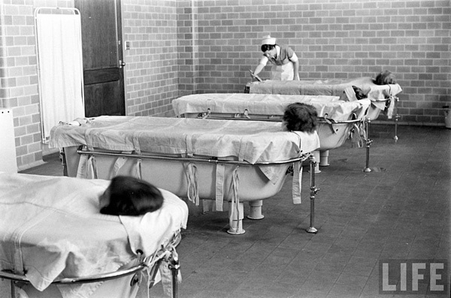
History of Pharmacological Treatments
Desperate cures
Sedatives and barbiturates
1950s lithium and major tranquilizers
Currently mood stabilizers, SSRIs, and atypical antipsychotics
Depends on the phase of treatment
Notes:
Also history of putting patients in hot baths, lobotomy, etc.

Slide 15
Treatment Objectives
Acute stabilization
Harm prevention
Preventing Relapse
Promoting Normal Development
Individual therapy to improve symptoms, safety, and self-control
Family therapy to bolster social supports and decrease family discord
Mitigation
Health
Financial
Legal
Occupational
Educational
Social

Slide 16
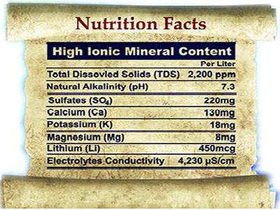
Lithium Carbonate, Citrate, or Sulfide
Pharmacodynamics
Absorption and distribution
Easily absorbed by gut
Slow across blood brain barrier
Metabolization
No first pass effect in liver
Elimination
Half life of 18 to 30 hours (very unpredictable)
Notoriously narrow therapeutic window
Toxic effects can be fatal, and include:
Nausea, vomiting, abdominal pain, ataxia, tremors, slurred speech, and cognitive difficulties
Very sensitive to salt (sodium chloride) intake and sweating
Associated with weight gain, thyroid disease, kidney disease, skin problems, and compromised immune sys
Pharmacodynamics
Antagonize 5HT autoreceptors and 5HT heteroreceptors on dopaminergic neurons
BDNF

Slide 17
Drug Mechanisms of Action
Notes:
Lithium Decrease dopamine and glutamate, increase GABA
Mechanisms of action, not well known…

Slide 18
Valproic Acid
FDA approved for seizure disorders, acute mania, and migraine headaches
Trade names include Valproate and Depacote
Pharmacodynamics
BDNF
GABA agonist (blocks reuptake) and growth promoter
Increase dopamine in prefrontal cortex but not Nucleus Accumbens
Inhibitory effect on glutamate NMDA receptor
Better tolerated than lithium
Side effects include sedation, tremor, ataxia, nausea, and weight gain
May be a good choice for rapidly cycling patients

Slide 19
Other Anticonvulsants “off label”
Acetazolamide
Acetazolam
Carbamazepine Tegretol Mazepine, Carbamazepine CR
Clobazam Frisium
Clonazepam Rivotril Clonpam, Clonazepam-R
Diazepam Valium, Diastat, Diazemuls, Dipam
Ethosuximide Zarontin
Fosphenytoin Cerebyx
Gabapentin Neurontin
Lacosamide Vimpat
Lamotrigine Lamictal
Notes:
Not well supported and/or contraindicated
Not studies in children
Side effects:
GI, CNS, Hematological, Hepatic, Dermatological
Nausea, blurred vision, skins rash, liver issues, horomonal changes weight gain,

Slide 20
Other Anticonvulsants “off label”
Levetiracetam Keppra
Lorazepam Ativan Loraz
Nitrazepam Mogadon Nitrazedon
Oxcarbazepine Trileptal
Phenobarbital
Phenobarb, Phenobarbital Sodium
Available in the United States
Felbamate (Felbatol)
Tiagabine Hydrochloride (Gabitril)
Zonisamide (Zonegran)
Phenytoin Dilantin Phenytoin Sodium, Tremytoine
Pregabalin Lyrica
Primidone
Rufinamide Banzel
Stiripentol Diacomit
Notes:
Not well supported and/or contraindicated
Not studies in children
Side effects:
GI, CNS, Hematological, Hepatic, Dermatological
Nausea, blurred vision, skins rash, liver issues, horomonal changes weight gain,

Slide 21
Other Anticonvulsants “off label”
Stiripentol Diacomit
Topiramate Topamax
Valproic Acid Epival, Depakene Divalproex Sodium, Sodium Valproate
Vigabatrin Sabril
Zonisamide (Zonegran)
Notes:
Not well supported and/or contraindicated
Not studies in children
Side effects:
GI, CNS, Hematological, Hepatic, Dermatological
Nausea, blurred vision, skins rash, liver issues, horomonal changes weight gain,

Slide 22
FDA approved Drugs for Pediatric USE
Lithium → FDA approved for adolescents ages 12+
Aripiprazole (Abilify) → FDA approved for bipolar I in children 10-17
Asenapine (Saphris) → FDA approved for bipolar disorders in children 10-17
Olanzapine (Zyprexa) → FDA approved for bipolar I in children 13-17
Quetiapine (Seroquel) → FDA approved for bipolar I in children 10-17
Risperidone (Risperdal) → FDA approved for bipolar I in children 10-17
Side effects:
GI, CNS, Cardiovascular, Endocrine, General
(weight gain, blurred vision)
Notes:
Lithium became widely know as a treatment around 1947, mineral water may have been a precursor of this, Lithium approved by FDA in 1970
Risperidone the first atypical antipsychotic
most research on BP1
Still severe side effects→ nausea, weight gain, prolactin levels, headaches, high blood pressure, cataracs,

Slide 23
Promising Pharmacological Treatments
Aripiprazole
Maintenance therapy
Limited research, needs to be compared with lithium
Notes:
Maintenance therapy→ limited research. Most studies are 8 weeks.
Aripiprazole
Lithium not as stable findings
Most studies reviewed for medication were for monotherapy. Treating depression in bipolar disorders alone is controversial in adults because it might induce mania. So this has been avoided in children

Slide 24
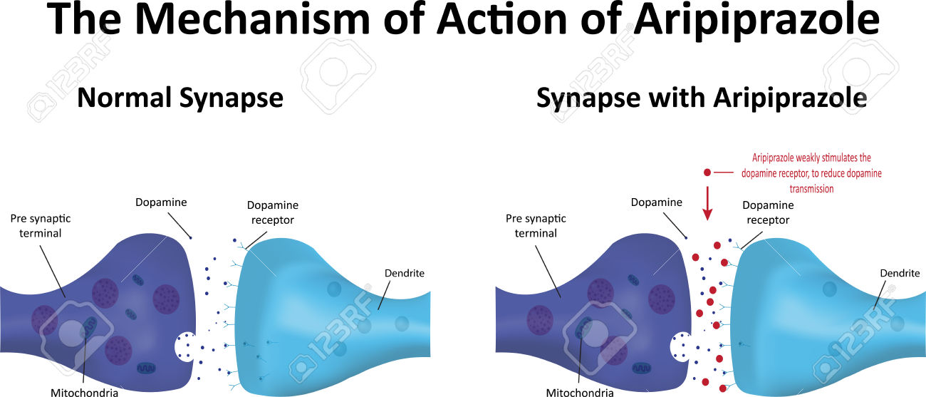

Slide 25
Promising Pharmacological Treatments
Pediatric Bipolar Depression
Olanzapine/fluoxetine (Symbyax) → FDA approved for ages 10-17
Notes:
Maintenance therapy→ limited research. Most studies are 8 weeks.
Aripiprazole
Lithium not as stable findings
Most studies reviewed for medication were for monotherapy. Treating depression in bipolar disorders alone is controversial in adults because it might induce mania. So this has been avoided in children

Slide 26
Non-Pharmacological Treatments
Psychoeducation as a stand alone treatment
Cognitive Behavioral Therapy
Family Focused Treatment
Psychoeducation
Family communication skills to decreased intra-familial stress
Problem solving
Interpersonal and Social Rhythm Therapy
Medication adherence
Stressful life events
Disruptions of social rhythms
CBT= FFT = IPSRT > psychoeducation alone

Slide 27
Combined Treatments
Meta analysis in 2017 by Macheiner et al
24 intervention groups
75% of combined (psychosocial and medication) > medication alone

Slide 28
Overall Best Practices
Multiple phases
Crisis intervention/ stabilization
Acute treatment- mania
Acute treatment – depression
Prevention of relapse

Slide 29
Overall Best Practices
Crisis intervention/ stabilization
Case management
Harm prevention
Hospitalization
Crisis stage transition plan

Slide 30
Overall Best Practices
Acute treatment – Mania Sequencing
Combined Therapy (Meds and Psychosocial)
Pharmacological monotherapy
SGAS
Mood stabilizer
Lithium
Multimodal Psychosocial CBT, FFT, or IPSRT
Family supports, psychoedcuation, case management
CBT
FFT
IPSRT
Polypharmacy
If necessary
SGAS and mood stabilizer

Slide 31
Overall Best Practices
Acute treatment – Depression Sequencing
CBT
Family supports, psychoeducation, case management
SSRI
Polypharmacy
Olanzapine/Fluoxetine

Slide 32
Overall Best Practices
Relapse prevention- Simultaneous
IRSRT
Family supports, psychoeducation, case management
Mood stabilizer (after mania)
Mindfulness (after depression)

Slide 33
Fin

