Slide 1
Attention-Deficit/ Hyperactivity Disorder
Gulden Esat and Kimberly Smoots

Slide 2
Brief Overview of ADHD
This Photo by Unknown Author is licensed under CC BY-SA
Notes:
Briefly, describe the disorder and provide a tool for progress monitoring of the disorder
identify an empirical article to critique, and make comments on the paper
Identify background readings for the class (up to two review articles or chapters)
provide an historical overview of the drugs used to treat the disorder
focus on the drug category currently considered the best pharmacological option for treating the disorder
identify the generic and trade names of some commonly used drugs included in the drug category
indicate pediatric FDA indications and common pediatric off-label usage
identify any FDA DSCs as well as common side effects and their implications for school learning and behavior
describe of the putative mechanism of action of the drug
describe pharmacological and non-pharmacological alternatives to the drug
comment on research about combined treatments
present your evaluation and argument for best practices for treating this disorder, including potential sequencing or combination treatments
discuss ways in which future studies might improve the current research
describe how this analysis may have changed your beliefs and/or attitudes toward the use of this drug

Slide 3
What is ADHD?
Age-inappropriate and impairing levels of
inattention,
and/or hyperactivity/impulsivity
Symptoms must be present prior age 12.
Manifestations of the disorder must be present in more than one setting.
Prevelance:5% of school-age children, 2.5% of adults worldwide.
Annual incremental costs for ADHD have been estimated at US$143–266 billion in the USA

Slide 4
Cont.
4
2 times more common in males
Approximately 50% of children born to a parent with ADHD will also have ADHD.
Etiology is multi-factorial, including genetic, neurochemical, neurophysiological, and psychosocial factors.

Slide 5
CONSEQUENCES OF UNTREATED ADHD
- Poor academic performance
- Increased risk for injuries - Low self-esteem related to performance - Poor interpersonal relationships - Clinical evidence of ↑ risk of substance abuse - Employment difficulties

Slide 6
Neurology of ADHD
- Decreased thalamic sensory activity (abnormal reticular activating system)
- Cortical hypo-arousal in the frontal and cingulate cortices
- Increase in theta activity
- Developmental trajecory differences in basal ganglia
- Delayed cortical maturation
- Depressed dopamine activity
Notes:
Cingulate – limbic system (satiation & reward)
Theta – EEG, slow waves

Slide 7
Treatment
This Photo by Unknown Author is licensed under CC BY-SA-NC

Slide 8
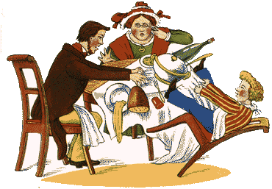
History of ADHD Treatment
Symptoms of ADHD as a disorder dates back to late 1700s.
The incapacity of attending with a necessary degree of constancy to any one object (Sir Alexander Crichton, 1763–1856)
Fidgety Phil (Heinrich Hoffmann 1809–1894)
Defect of moral control (Sir George Frederic Still, 1868–1941)
Postencephalitic behavior disorder, Tredgold
Hyperkinetic disease of infancy (Franz Kramer 1878–1967, and Hans Pollnow 1902–1943)
Lange et al., (2010)

Slide 9
History of ADHD Treatment
In 1937, Charles Bradley performed pneumoencephalograms in order to examine structural brain abnormalities→ caused headaches → he treated them with benzedrine which was the most potent stimulant available at the time .
He found that Benzedrine improved children’s school performance
The children with the best affects had the following symptoms “short attention span, dyscalculia, mood lability, hyperactivity, impulsiveness, and poor memory”
This discovery was unpopular due to the current beliefs about behavior and treatment use of psychotherapy (psychoanalysis)
Lange et al., (2010)
Notes:
Pneumoencephalography was a common medical procedure in which most of the cerebrospinal fluid was drained from around the brain by means of a lumbar puncture and replaced with air, oxygen, or helium to allow the structure of the brain to show up more clearly on an X-ray image.
This usually caused severe headaches, which were supposed to be the result of a significant loss of spinal fluid. Bradley attempted to treat the headaches by stimulating the choroid plexus with

Slide 10
Benzedrine
Benzedrine, colloquially referred to as bennies, is an equal parts mixture of levoamphetamine and dextroamphetamine.
It was first marketed in 1933 as a decongestant in the United States in the form of Benzedrine inhalers. Benzedrine sulfate was introduced three years later and was used to treat a wide variety of medical conditions, including narcolepsy, obesity, low blood pressure, low libido, and chronic pain, among others.

Slide 11
History of ADHD treatment
Use of stimulants to treat ADHD did not come until 25 years after and Benzenedrine was used.
But in 1944, Leandro Panizzon used and marketed the first use of Methylphenidate as “Ritalin” by Ciba-Geigy Pharmaceutical Company in 1954. Most commonly used now for treatment of ADHD.
In 1999, the National Institute of Mental Health (NIMH) study determined that stimulant use was superior than intensive behavior and community-based treatments alone.
Rise in diagnosis and treatment use.
Now a greater shift in other types of medicine other than methylphenidate because of stigma and side effect.
Lange et al., (2010)

Slide 12
Treatment History MPH
Methylphenidate (MPH), a central nervous system (CNS) stimulant, of the phenethylamine class, is commonly used for ADHD and narcolepsy. The drug, first synthesized in 1944 and launched as Ritalin, was first used for the treatment of lethargy, narcolepsy, chronic fatigue, disorders associated with depression and what was then known as hyperkinetic impulsivity.

Slide 13
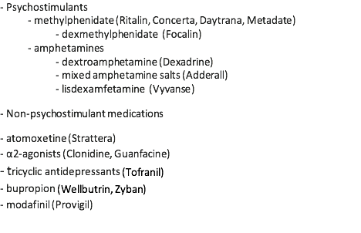
Current Pharmacological Treatment
This Photo by Unknown Author is licensed under CC BY-NC-ND

Slide 14
Non-Pharmacological Therapy
Family-focused interventions
Education
Support groups
Parent Management Training
School-focused interventions
Classroom modifications
Tutoring
Calendars or electronic organization devices
Child-focused interventions
Education about ADHD
Psychosocial therapy
Alternative/Complimentary Treatment
Nutrition
Exercise

Slide 15
FDA Approvals
Notes:
https://www.cms.gov/Medicare-Medicaid-Coordination/Fraud-Prevention/Medicaid-Integrity-Education/Pharmacy-Education-Materials/Downloads/stim-pediatric-factsheet11-14.pdf

Slide 16
Standardized Dosing Information
https://www.cms.gov/Medicare-Medicaid-Coordination/Fraud-Prevention/Medicaid-Integrity-Education/Pharmacy-Education-Materials/stimulant-education.html
Notes:
https://www.cms.gov/Medicare-Medicaid-Coordination/Fraud-Prevention/Medicaid-Integrity-Education/Pharmacy-Education-Materials/Downloads/stim-pediatric-dosingchart11-14.pdf

Slide 17
Mechanisms of Action of the Drug

Slide 18
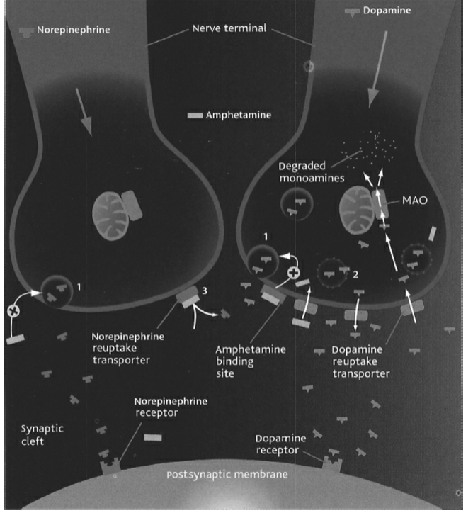
Pharmacodynamics Amphetamines increase synaptic concentrations of both norepinephrine and dopamine by (1) blocking reuptake transporters for norepinephrine as well as increasing the amount of NE released into the synapse. (2) binding to the vesicular transporter and cause dopamine to be released from its storage vesicles into the cytoplasm of the terminal button. This “free” dopamine is then transported into the synaptic cleft by amphetamine-induced reversal of the dopamine transporter (DAT). (3) increasing the amount of dopamine released from synaptic vesicles during neuronal signaling. Dopamine contributes to cortical arousal via the mesocortical pathway originating in the nucleus accumbens. Increased NE activity contributes to cortical
arousal via the reticular activating system originating in the locus coeruleus .

Slide 19
Pharmacokinetics of MPH
- Average half-life is 3.5 hours (1.3-7.7hours) and 2.5 hours (1.5-5 hours) in adults and children respectively. - First-pass metabolism is not extensive with transdermal dosing, thus resulting in notably higher exposure to MPH and lower exposure to metabolites as compared to oral dosing.
- High abuse potential, Schedule II drug
- Patient may develop tolerance and psychological dependence •
- Discontinuation: Taper to avoid withdrawal effects. Careful supervision is required during withdrawal from abusive use.

Slide 20
Amphetamines - Insomnia, - Nervousness,
- Irritability, - Weight loss, - Dizziness. - Hypertension, - Tachycardia, - Cardiac arrhythmias. - Excessive doses induce psychotic states, seizures, and cardiac failure. Methylphenidate - Apettite loss - High BP - Stomach pain - Headache - In 2003–2005, several studies were released suggesting that MPH might be associated with an increase in cancer (El-Zein et al., 2005). However, larger follow-up studies conducted in Germany found no such association (Walitza et al., 2007). - No evidence for delayed growth or maturation (Wilens et al., 2005).

Slide 21
Considering the symptoms…
What kinds of factors would you track for progress monitoring?

Slide 22
Progress Monitoring Tools

Slide 23
More tools!
Notes:
myadhd

Slide 24
Self-made progress monitoring tool
Please rate student’s behavior daily using the following scale:
Please rate student’s behavior daily using the following scale:
1=Low | 2=Average | 3=High | 0= Not available or not in class
 | Morning Rating | Afternoon Rating
Activity Level
Attention
Compliance w/ Directions
Work Completion
Appetite

Slide 25
Research Summary & Critique

Slide 26
Cortese, S., Adamo, N., Del Giovane, C., Mohr-Jensen, C., Hayes, A. J., Carucci, S., ... & Hollis, C. (2018). Comparative efficacy and tolerability of medications for attention-deficit hyperactivity disorder in children, adolescents, and adults: a systematic review and network meta-analysis. The Lancet Psychiatry, 5(9), 727-738.
efficacy on core ADHD symptoms,
clinical global functioning,
tolerability,
acceptability,
blood pressure and weight changes.

Slide 27
Critique
Includes
randomized double-blind trials
dissertations/thesis
unpublished results
assessments of
risk of bias with Cochrane
certainty of evidence with the Grading of Recommendations Assessment, Development, and Evaluation (GRADE)
Effect of the following modifiers was investigated
duration of study,
gender,
age,
psychiatric comorbidities,
IQ,
crossover design,
medication status,
industry sponsorship,
inequalities in doses,
data imputation,
risk of bias.
Risk of Bias | low | unclear | high
Children and Adolescents | 23.5% of the studies | 65.4% | 11.1%
Adults | 27.5% | 56.8% | 15.7%

Slide 28
FINDINGS
Amphetamines significantly increased diastolic blood pressure in children and adolescents, but not in adults.
Atomoxetine had the lowest mean effect size in children and adolescents based on clinicians’ ratings, but in adults, its efficacy on ADHD core symptoms was comparable with that of methylphenidate.
No significant difference between amphetamines and methylphenidate on the CGI-I measure.
Notes:
The large confidence interval in relation to the efficacy and tolerability of bupropion, clonidine, guanfacine, and modafinil suggests that caution should be used when interpreting these data.

Slide 29
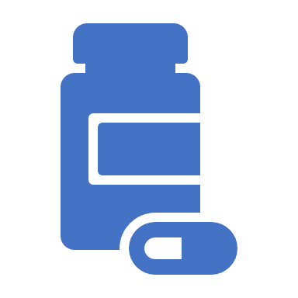
CGI-Improvement (CGI-I)
“Compared to the patient's condition at admission to the project [prior to medication initiation], this patient's condition is:
1=very much improved since the initiation of treatment;
2=much improved;
3=minimally improved;
4=no change from baseline (the initiation of treatment);
5=minimally worse;
6= much worse;
7=very much worse since the initiation of treatment.”

Slide 30
Notes:
In children and adolescents, methylphenidate was the only drug with better acceptability than placebo; in adults, amphetamines were the only compound with better acceptability than placebo.

Slide 31
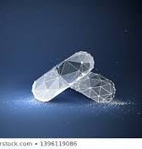
Accounting for all included outcomes, the results support methylphenidate in children and adolescents, and amphetamines in adults, as the first pharmacological choice for ADHD.

Slide 32
Li, Y., Gao, J., He, S., Zhang, Y., & Wang, Q. (2017). An evaluation on the efficacy and safety of treatments for attention deficit hyperactivity disorder in children and adolescents: a comparison of multiple treatments. Molecular Neurobiology, 54(9), 6655-6669.
Used the parent rating scales not the teachers.
LDX has the highest efficacy compared to the other drugs as well as a relatively lower rate of causing adverse effects than BUP, CLON and GXR. Safety ranking 4th.
MPH has the lowest incidence rate of withdrawals due to adverse effects. In terms of efficacy, takes second place in ADHD-RS and third place in CPRS.
ATX is the safest drug. It has the lowest incidence rate of all-cause withdrawals as well as withdrawals due to lack to efficacy. However, the efficacy of ATX seems to be lower than CLON, GXR, LDX and MPH.
The use of CLON may be controversial considering its high efficacy but relatively low safety rate.
The efficacy of selective norepinephrine-reuptake inhibitors ATX and BUP (related to epileptic seizures) might not be as high as other medications.
As reported previously by the Texas Children’s Medication Algorithm Project (2006), BUP was listed as a fourth-line medication for ADHD.

Slide 33
Catala-Lopez, F., Hutton, B., Núñez-Beltrán, A., Page, M. J., Ridao, M., Saint-Gerons, D. M., ... & Moher, D. (2017). The pharmacological and non-pharmacological treatment of attention deficit hyperactivity disorder in children and adolescents: a systematic review with network meta-analyses of randomised trials. PloS one, 12(7), e0180355.
Behavioral therapy (alone or in combination with stimulants), stimulants and non-stimulants seemed significantly more efficacious than placebo; stimulants seemed superior to behavioral therapy
Cognitive training and non-stimulants; and behavioral therapy in combination with stimulants seemed superior to monotherapy with stimulants or non-stimulants.
Among single drug agents, methylphenidate, amphetamine, atomoxetine, guanfacine, clonidine and modafinil seemed significantly more efficacious than placebo.
Methylphenidate and amphetamine seemed more efficacious than atomoxetine and guanfacine.
Behavioral therapy and stimulants (and their combination), showed the best profile of acceptability leading to significantly fewer discontinuations that did placebo.
Methylphenidate and clonidine seemed superior to placebo, whereas methylphenidate and clonidine seemed better accepted than atomoxetine.
Most of the efficacious pharmacological treatments (particularly stimulants) were associated with anorexia, weight loss and insomnia.
Behavioral therapy, particularly given by parents and with active child and teacher involvement, is the only non-pharmacological intervention that was found to be associated with statistically significant benefits.
Cognitive training, neurofeedback, dietary therapy (such as restricted elimination diet), polyunsaturated fatty acids, amino acids, minerals, herbal therapy, homeopathy, and physical activity cannot be recommended as evidence-based interventions.
Notes:
Medication Algorithim

Slide 34
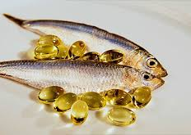
Omega 3/6?
Contradicting results
Good complimentary treatment
No serious side effects

Slide 35
Moscibrodzki, P., & Katz, C. L. (2018). Methylphenidate Hydrochloride
ADHD & MENTAL RETARDATION
In a 4-week, single-blind, parallel-group trial, 45 subjects with moderate mental retardation and ADHD were randomized to risperidone or methylphenidate (ages 6 -16). Both drugs were titrated to a maximum tolerable dose.
Risperidone was associated with greater reductions in ADHD total score than methylphenidate in children with moderate mental retardation and ADHD.
Notes:
Risperidone – decreases hallucinations in psychosis but sedates others and causes weight gain

Slide 36
ADHD & AUTISM SPECTRUM DISORDER
Four cross-over randomized clinical trials were included with a total of 113 children (aged 6 to 18 years) . High-dose methylphenidate had a significant and clinically relevant benefit on hyperactivity as rated by teachers and parents and a significant but not clinically relevant benefit on teacher-rated inattention. There was no evidence that methylphenidate worsens the core symptoms of ASD or benefits social interaction, stereotypical behaviors, or overall ASD, as rated by teachers.

Slide 37
ADHD & OPPOSITIONAL DEFIANT DISORDER AND AGGRESSION
In an open-label comparative study, children with ADHD, aged 8-18 years with (n=30) and without (n=30) oppositional defiant disorder (ODD) received MPH treatment for 12 weeks (47). Significant reductions in Suspiciousness Rating Scale scores were detected in both groups following MPH treatment.
Only in the ADHD/ODD group a significant correlation was found between the rate of improvement in ADHD, as assessed by the ADHD-RS, and the reduction in suspiciousness, as assessed by the SRS (Spearman r = 0.48, p = .0066).
Another study, 40 drug-naïve male youths diagnosed as having ADHD-combined presentation, comorbid with ODD and aggression, without psychiatric comorbidities. 20 were treated with MPH (mean age, 8.95 ± 1.67 years) and 20 treated with risperidone (mean age, 9.35 ± 2.72 years) followed up to 6 months, both medications were similarly effective based on subscales of aggression and rule-breaking behaviors, but only MPH was effective on attention problems and attention-deficit/hyperactivity problems .

Slide 38
Final thoughts and Overall Best Practice

Slide 39
Best Pharmacological Treatment
ADHD TREATMENT GUIDELINES
First-line: Methylphenidate or amphetamine
Second-line: Atomoxetine
Third-line: Bupropion, TCAs, or alpha-agonists
Behavioral therapy is the first-line treatment for young age group (4 – 5 years) -American Academy of Pediatrics
Primary care clinician may prescribe methylphenidate if the behavior therapy does not provide significant improvement and the child continues to have moderate to severe symptoms
Dual treatment with two different stimulant medications has not been shown to be effective and is not considered appropriate therapy.

Slide 40
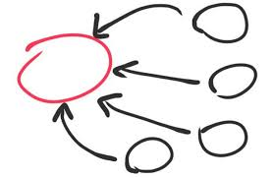
CONCLUSION
Moderate impairment:
1- behavioral treatment only
2- addition of LDX
3- MPH
4- AMX
Severe impairment
1- combination treatment

Slide 41
Any thoughts?
Any questions? Comments?

Slide 42
Large Photo Slide
42
This Photo by Unknown Author is licensed under CC BY-SA-NC

Slide 43
References
Lange, K. W., Reichl, S., Lange, K. M., Tucha, L., & Tucha, O. (2010). The history of attention deficit hyperactivity disorder. Attention deficit and hyperactivity disorders, 2(4), 241–255. doi:10.1007/s12402-010-0045-8

