Slide 1
Spirituality, Mental health & laws
By: Syed Rizvi

Slide 2
What is spirituality?
Spirituality is an individualized approach to making sense and understanding a transcendental dimension of reality (Kapuscinski & Masters, 2010).
Spirituality is having the capacity to experience sacred or transcendental dimensions which can provide meaning to one’s existence and further one’s pursuit in understanding life (Dierendonck, 2006).
Spirituality may be an experiential commitment to one’s belief system or a strive for a deeper connection with oneself, others, nature and/or with the Transcendent (God, the Universe, etc.) (Meezenbroek et al., 2012).
Spiritual experiences can happen beyond the scope of religion such as individual experiencing nature in a ‘spiritual’ manner and being deeply moved by the experience (Meezenbroek et al., 2012).
Notes:
Vaughn (1991) stated that spirituality was more of an experience of something sacred. Vaughn also described spirituality as “a quality that goes beyond religious affiliation, that strives for
inspirations, reverence, awe, meaning and purpose, even in those who do not believe in any God” (Vaughn, 1991, p. 105 ).
Reed (1992) defined spirituality on the basis of conceptual, empirical, and clinical nursing literature as the propensity to make meaning through a sense of relatedness to dimensions that transcend the self in such a way that it empowers and does not devalue the individual. This relatedness can be experienced intrapersonally (as a connectedness within oneself), interpersonally
(in the context of others and the natural environment) and transpersonally (referring to a sense of relatedness to the unseen, God, or power greater than the self and ordinary source).

Slide 3
How spirituality affects mental health
Many moderating variables in the Spirituality – Well-Being link including connectedness, self-knowledge, inner harmony, mindfulness, authenticity, compassion (towards self and others), gratitude, natural curiosity, openness to experience and search for meaning in life (Meezenbroek et al., 2012).
Also adjusts one’s worldview in that individuals are better able to assimilate traumatic or stressful events cognitively through mental appraisals and enhancing self-control (Poulin, Silver & Holman, 2011).
Helped in patients adjustment to cancer diagnosis and treatment (Aldwin et al., 2014).
Spiritual beliefs, practices and commitments are linked with both psychological and physical well-being including marital satisfaction, better interpersonal functioning and improved QOL (Seybold & Hill, 2001).
Notes:
Can promote psychological resiliency during stressful situations; related to positive affect and reduced dysphoria after traumatic events (Poulin, Silver & Holman, 2011).

Slide 4
Part of one’s meaning system
Global meaning is described as an individual’s framework of beliefs, goals and the sense of meaning they derive from day-to-day functioning (Park, 2010).
Religious tradition is not good indicator of the importance of spirituality (Molzahn et al., 2012).
Shapes beliefs (nature of humanity, free will, destiny, karma), provides ultimate motivation towards goals (guidelines in how to achieve these goals as well), along with a profound sense of purpose in what we are doing (Uwland-Sikkema, Visser & Westerhof, 2018).
Beliefs
Goals
Sense of Purpose
Notes:
Through this framework, people structure their lives and assign meanings to specific experiences. Global beliefs are assumptions that people make regarding their own nature as well as their
understanding of other people, including beliefs regarding self-identity, control, and justice.
Global goals are high level ideals, states, or objects toward which people work, or which they seek to maintain, such as health, relationships, or work. A sense of meaning
refers to feelings of “meaningfulness,” which may be derived from seeing one’s action as oriented or making progress toward a desired future goal
The types of meaning systems were named “omnipresent spirituality” (Type 1), “accompanying spirituality” (Type 2), “enclosed spirituality” (Type 3), and “absent spirituality” (Type 4) in an interview with cancer patients suffering: Type 1 spirituality appears as an overarching set of beliefs, attitudes, and experiences that seems to infuse all aspects of the person’s meaning system (omnipresent spirituality); Type 2 spirituality appears in the background of the meaning system portrayed by a personal and supporting God (accompanying spirituality); Type 3 spirituality is hidden within the general beliefs, attitudes, and experiences and is expressed by a transcendent image and experience of oneself (enclosed spirituality); Type 4 spirituality does not appear or only as a few isolated spiritual experiences and beliefs (absent spirituality).

Slide 5
Integrative work
What is a Psychologists role in understanding a patients R/S?
Vieten et al., (2013)
View it as part of diversity and culture embedded in APA guidelines.
Should be aware of R/S resources and practices that may support psychological well-being.
Should be able to identify legal and ethical issues that may surface in relation to R/S that may surface.

Slide 6
Laws relating to r/s
First Amendment: “Congress shall make no law respecting an establishment of religion..” Establishment Clause prohibits the Federal govt. from creating a national religion or excessively involving itself in religion.
1
Free Exercise Clause: ‘Right to free exercise religion is not absolute’ however as in Reynolds v. United States where Chuch of Latter-Day Saints members were prohibited from polygamy.
2
Fourteenth Amendment: Prohibits discrimination based on religion.
3
Religious Freedom Restoration Act: Prevents other federal laws from burdening one’s free exercise of religion (i.e., Native American use of peyote as part of one’s religion).
4
Lemon Test: Lemon vs. Kurtzman established that laws dealing with religion had to (1) have a secular purpose, (2) neither advance nor inhibit religion and (3) do not foster an excessive govt. entanglement with religion
5
Notes:
14th: All persons born or naturalized in the United States, and subject to the jurisdiction there of, are citizens of the United States and of the State where in they reside. No state shall make or enforce any law which shall abridge the privileges or immunities of citizens of the United States; nor shall any State deprive any person of life, liberty, or property, without due process of law; nor deny to any person within its jurisdiction the equal protection of the laws.
Church of the Lukumi Babalu Aye v. City of Hialeah in 1993 upheld the right of Santeria adherents to practice ritual animal sacrifice with Justice Anthony Kennedy stating in the decision, "religious beliefs need not be acceptable, logical, consistent or comprehensible to others in order to merit First Amendment protection".

Slide 7
Teaching religion
According to ADL; religion may be presented as part of a secular educational program but must be discussed in a neutral, objective and factual manner.
Teachers must not interject personal views and must be extremely sensitive to respect, and not interfere with, a student’s religious beliefs (ACLU).
De Ruyter and Merry (2009) argue that religious ideals should be incorporated into public school curriculum.
Differentiate between ideals and dogmas (i.e., ideals referring to excellences which people aspire to and dogmas being expectations that people have to pursue).
Encinitas vs. Sonima (2013) ruling on yoga program taught in schools found that is was ‘devoid of any religious, mystical or spiritual trappings’ but the case speaks on wider issue..
Notes:
role of religion in the historical, cultural, literary and social development of the U.S. for example) but must be discussed in a neutral, objective and factual manner.
On the contrary, we believe that they are essential ‘big ideas’ that everyone, including students in public schools, should be acquainted with for human beings to live a purposeful life. One of us has in fact argued elsewhere that students need to acquire religious literacy and spiritual values in schools.
What is generally agreed is that spirituality is a distinctive capacity for the individual to make sense of oneself within a wider framework of meaning and see oneself as part of some larger whole.

Slide 8
Spirituality and religiosity
Spirituality
Feeling
Meaning
Connection
Religion
Beliefs
Rituals
Behaviors
Notes:
Religion ,represented with this rectengal here is a structured and institutionalized experience of beliefs, rituals and behaviors. So different religions may have different beliefs, rituals and behaviors pertaining to being religious. It is more prescriptive and can be observed. Spirituality on the other represented by this heartshape is not observable, it is an inner experience of feelings, meaning and connection with ones self, with other or with the transcendent. The experience of spirituality as a process is similar across different religions. There are some people who are religious and spiritual at the same time, who only prefer to be religious but does not embrace spituality as much, and there are some people who are spiritual but do not feel connected to any religion.

Slide 9
Spirituality and mental-health
Notes:
Spiriutality has been studied in the field of medicine mainly as a protective factor. When we look at the lietarture mostly derived from psychiatic or nursing studies, spirituality can be something we can utilize in the field of school psychology. These are the moderating variables in the spirituality well-being link, slf awareness, mindfulness, compassion,gratitude which are the core constructs of mindfulness trainings. Also the direct outcomes of spirituality are increased optimis, self esteem, well-being and happiness. These are the qualities that we want to cultivate in out students. And coming from an ecological perspective, not only the students bt the teachers, administrative staff and also parents could be provided with universal preventive interventions to promote well-being.

Slide 10
Why is it worth promoting spiritual ideals in our education system?
Promotion of spiritual ideals is linked to greater self-reflection, attribution to meaning of daily experiences and emphasis of non-material dimensions of life (Ofsted, 1994).
Spirituality is one of the strongest protective risk-factors for adolescents and adults; one of the strongest links to well-being we have in science (Barnett & Johnson, 2011).
Existential questions of self-knowledge, transcendence and higher meaning are fundamental markers of one’s worldview.
OUR OWN RESEARCH! Student’s are ALREADY perceiving our content as spiritual!

Slide 11
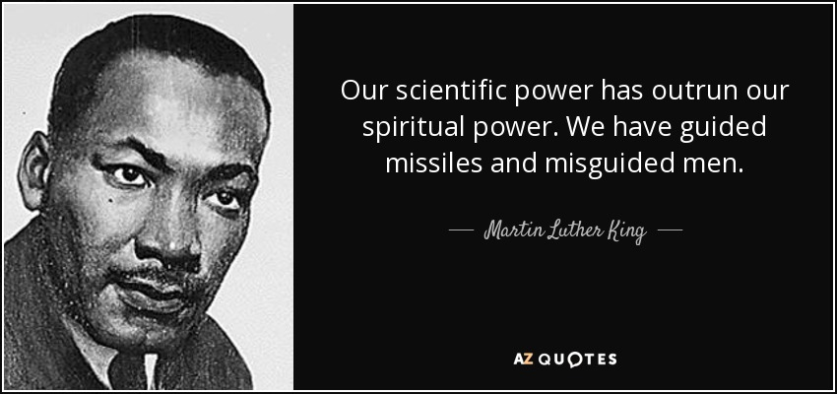
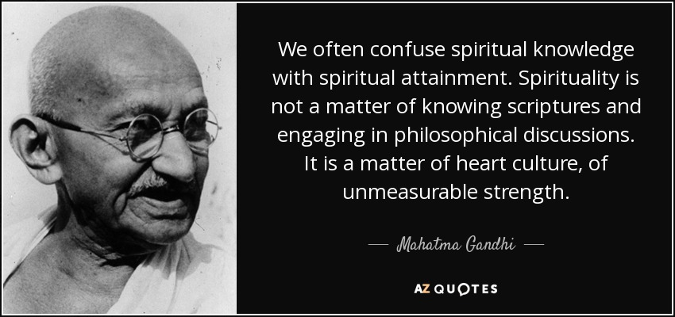
Design thinking approach
Whole-school approach –transmit spiritual ideals through civics and moral education.
Applying values such as brotherhood/sisterhood, compassion, interconnectedness.
Students take the 1st step towards recognizing moral and spiritual values related to their existence.
Human-centered, active and collaborative manner.
Promoting religious understanding – “there are many ways that various spiritual traditions approach communal harmony, some examples are…”

Slide 12
Two approaches (tan & Wong, 2012)
Religiously tethered
Tying in spiritual ideals with religious concepts to promote clarity and cultural understanding.
Ex: explicitly mentioning prayer through various spiritual approaches when we speak about mindfulness.
Creating safe-space for students to speak about their own attitudes towards spirituality and religion.
Religious beliefs and practices are presented to develop empathetic awareness, self-reflection and contemplation.
Top-down approach
Religiously untethered
Spiritual ideals are only loosely tied (if at all) with their religious affiliations.
Ex: speaking about John-Kabat Zinn and other secular scientists when we introduce mindfulness with minimal references to Buddhist philosophy.
Bottom-up approach; values and ideals are cultivated first, students are given space and time to explore their sense of self before its spiritual context is introduced.

Slide 13
Mindfulness-spirituality approach
How do we accomplish this?
Evidence-based techniques:
Psychoeducation – basic principles of mindfulness are not only compatible with a spiritual worldview, but can be supplemental towards better overall health (citation).
Tying in our lessons, meditations and activities with core spiritual values from students.
Communal approach – first lesson can be a class-wide conversation on how to best approach spirituality (and religion secondary).
My thoughts:
Students preconceived ideas of spirituality (even if it is religious) can be spoken about in context with mindfulness (if they are comfortable)
Strong moral, ethics and communal foundation to a spiritual worldview.
Emic approach which helps students understand how various ancient traditions and wisdoms have approached ‘mindfulness’.

Slide 14
Teaching spirituality
Tan and Wong (2012) advocate spiritual ideals and education as a counter-response to religious education.
Spirituality can function as either religiously-tethered (divinity, prayer, heaven) or religiously-untethered (self-knowledge, personal cultivation, quest for meaning and beauty).
Can include teaching religions in a less formal and structured way: aim is for students to develop empathetic awareness and self-reflection on various religions.
Spiritual education and development enables students to acquire insights into their existence, value life beyond materialism, and transcendent beyond utilitarian function of the world (Ofsted, 1994).

Slide 15
Systematic shift
If incorporated; spiritual education can help students explore different spiritual ideals (i.e., exploring meaning through Hinduism and Confucianism) which promotes critique and discussion developing students reasoning and critical thinking skills.
Allows for nuanced, respectful and empathetic discussion of spiritual concepts without indoctrination and promotes the idea of ‘separation of church and state’.
Tan and Wong (2012) advocate design thinking approach which allows students to adopt a human-centered lens in working with individuals of different spiritual ideals and understand R/S on a more abstract level.
Can make for more profound implementation of mindfulness practices such as meditation which are stronger with a spiritual incorporation (Greeson et al., 2015)
Notes:
Students, especially adolescents, are already preoccupied with tackling the ‘large questions’: who am I? What’s my purpose? What sort of world do I want to help create? What is the meaning in life? These are essentially spiritual questions which our academic institutions can do a better job of incorporating.
Therefore the role of the teachers is to get their students to participate in a suitably designed design thinking project that will provide the students with the opportunities to not only sharpen and extend their disciplinary knowledge and skills through real-world application, but also appreciate in a deep and meaningful way the similarities and differences among people.

Slide 16
How can we do this?
Walsh (2016) lists a few suggestions for how public schools can integrate spiritual education:
Confusion of religion and spirituality in community members must be assuaged.
School systems must adopt a working definition of spiritual development, which consequently will lead to an integrative approach on what will lead to spiritual development.
Holistic educators must collaborate with secular educators in convergent strategies and goals (i.e., teaching students to foster a deeper connection to self, others, community, environment, etc.)
5 minute meditation time with the whole school participating vs. one or two classrooms.
Importance of educators to foster their own spiritual development.
Systems-wide approach and buy-in from power holders who value spiritual development; students who are fostered with deep connection with who they are and others will grow up to be compassionate, caring and community-centered citizens.
Notes:
The school should adopt a whole-school approach where its motto, vision, ethos and curriculum design converge on selected spiritual ideals such as the quest for knowing oneself
and serving others. These spiritual ideals can then be transmitted through the total curriculum, especially through subjects such as civics and moral education, and activities such as community involvement and service learning.
With appropriate facilitation from their teachers, students can then be guided to reflect upon more universal and transcendental aspects of the human experience – essentially what spiritual education is about. We should clarify that we are not prescribing or recommending design thinking as a template or blue-print for teachers and students to follow rigidly.

Slide 17
Public school & r/s
School Choice: Enables parents more control over child’s education by enabling them to choose a school that provides religious instruction.
School Voucher:
Debates on whether school vouchers improve or denigrate school system.
Vouches shift millions of taxpayers dollars from public schools, which are open to all faiths, to private schools which are mostly religious (thus taxpayers are directly funding religious instruction)
Private religious schools are not required to comply with many academic standards and can discriminate based on religion (ACLU).
Religious liberty in public schools protects students voluntarily ability to pray and express religious viewpoints, provided they do not interfere with the education of other students (ALCU)
Notes:
proponents argue it promotes free market competition (studies have shown that public schools are forced to compete for greater test-scores when situated close to eligible private schools), leads to greater private school sector growth with a much lower per-pupil cost than public schools but opponents argue that it erodes educational standards, difficult to get in for lower SES families and selects students from preferred groups (ethnicity, religion, etc.) and teaches anti-scientific material such as creationism.
"When Schools Compete: The Effects of Vouchers on Florida Public School Achievement" (Manhattan Institute for Policy Research, 2003), which concluded that public schools located near private schools that were eligible to accept voucher students made significantly more improvements than did similar schools not located near eligible private school
A CATO Institute study of public and private school per pupil spending in Phoenix, Los Angeles, D.C., Chicago, New York City, and Houston found that public schools spend 93% more than estimated median private schools
Students have the right to pray individually or in groups, express their religious beliefs in homework and artwork where those beliefs are germane to the assignment, read religious literature during student activity times, form religious clubs in secondary school and have equal access to campus media to announce their meetings, and wear T-shirts with religious messages.

Slide 18
Lack of training
The Joint Commission on the Accreditation of Healthcare Organizations (JCAHO), requires a spiritual assessment as a standard element of patient care (JCAHO, 2008). In contrast, the field of psychology has yet to establish a research-based consensus on spiritual/religious competencies and standards (Hathaway, 2008).
Vogel (2013): 84-90% of medical schools offer courses on spirituality and health; whereas recent analysis of 292 APA-accredited psychology training programs relied on ‘informal’ or ‘unsystematic’ training in religious diversity.
75% of the public agree that their approach to life is based on their religion, only 35% percent of psychologists surveyed agree with this statement (Delaney et al., 2007).
Evidence that psychologists hold explicit and implicit biases against perceived client religiosity. (O’Connor & Vandenberg, 2005; Ruff, 2008).
Delaney, H. D., Miller, W. R., & Bisono, A. M. (2007). Religiosity and spirituality among psychologists: A survey of clinician members of the American Psychological Association. Professional Psychology: Re- search and Practice, 38, 538–546. doi:10.1037/0735-7028.38.5.538;
Hathaway, W. L. (2008). Clinical practice with religious/spiritual issues: Niche, proficiency or specialty? Journal of Psychology and Theology, 36, 16–25.

Slide 19
Understanding R/s
Spiritual and religious competencies are defined as a “set of attitudes, knowledge, and skills in the domains of spirituality and religion that every psychologist should have to effectively and ethically practice psychology, regardless of whether or not they conduct spiritually oriented psychotherapy or consider themselves spiritual or religious.” (Vieten et al., 2012).
“The current version of the APA Code asserts that psychologists have an ethical responsibility to consider religious issues as an aspect of multicultural diversity along with gender, race and others (Principle E).”
American Psychological Association. (2009a). Guidelines and principles for accreditation of programs in professional psychology. Washington, DC: American Psychological Association.
Vieten, C., Scammell, S., Pilato, R., Ammondson, I., Pargament, K. I., & Lukoff, D. (2013). Spiritual and religious competencies for psychologists. Psychology of Religion and Spirituality, 5(3), 129.

Slide 20
References
Aldwin, C. M., Park, C. L., Jeong, Y.-J., & Nath, R. (2014). Differing pathways between religiousness, spirituality, and health: A selfregulation perspective. Psychology of Religion and Spirituality, 6, 9–21. http://dx.doi.org/10.1037/a0034416
de Jager Meezenbroek, E., Garssen, B., Van den Berg, M., Tuytel, G., Van Dierendonck, D., Visser, A., & Schaufeli, W. B. (2012). Measuring spirituality as a universal human experience: Development of the Spiritual Attitude and Involvement List (SAIL). Journal of Psychosocial Oncology, 30, 141–167. http://dx.doi.org/10.1080/07347332.2011.651258
De Ruyter, D.J., and M.S. Merry. 2009. Why education in public schools should include religious ideals. Studies in Philosophy and Education 28: 295–311.
Molzahn, A., Sheilds, L., Bruce, A., Stajduhar, K., Makaroff, K. S., Beuthin, R., & Shermak, S. (2012). People living with serious illness: Stories of spirituality. Journal of Clinical Nursing, 21, 2347–2356. http://dx.doi.org/10.1111/j.1365-2702.2012.04196.x
Ofsted. 1994. Spiritual;moral;social and cultural development. An Ofsted discussion paper. London: Office for Standards in Education.
Park, C. L. (2010). Making sense of the meaning literature: An integrative review of meaning making and its effects on adjustment to stressful life events. Psychological Bulletin, 136, 257–301. http://dx.doi.org/10.1037/a0018301
Tan, C., & Wong, Y. L. (2012). Promoting spiritual ideals through design thinking in public schools. International Journal of Children's Spirituality, 17(1), 25-37.
Uwland-Sikkema, N. F., Visser, A., Westerhof, G. J., & Garssen, B. (2018). How is spirituality part of people's meaning system?. Psychology of Religion and Spirituality (2018).
Walsh, S. (2016). Teaching The Whole Child: Fostering Spiritual Development in Public Education

