Slide 1
Behavior improvement plan: A case study
By: Syed Rizvi

Slide 2
Target behavior, client and the program
Target Behavior: Increasing prayer length
A Muslim engages in the spiritual practice of prayer five times a day ranging from sunrise to sunset.
This is a self-administered intervention by the client ➔ self-assessment, self-monitoring/observation, and self-reinforcement.
8 Week trial: 10/29-12/24

Slide 3
Criteria for identify behavior & Operational definition
Prayer serves to promote a high functioning or adaptive behavior as spirituality and mindfulness have been implicated in better well-being and life satisfaction.
Rigid definition of prayer Task Analysis
Starting point: wudu or ablution of the skin.
Call to prayer, succession of prostration and standing (rakaat), according to time of day.
Ending point: Last rakaat.

Slide 4
Measuring the behavior
Prayer App which alerts user of approaching prayer.
Frequency count which tallies every prayer set on my memo app.
Observations of client behavior could be obtained naturally. Ongoing performance of the client was observed as it normally occurred.
Prayer can be performed in a number of natural settings (school, mosque, home, staircase)

Slide 5
FBA
1. Collecting Information
(1) does the undesired behavior (not praying) result in some sort of reinforcing consequence? ➔ I have been practicing meditation with great benefits for the last few years, the biggest obstacle is turning prayer into a habitual routine. There is also a spiritual component missing from my daily prayer.
Automatic reinforcement, social attention and escape/avoidance
Spiritually/emotionally nourishing
Drawing yourself closer to the Muslim community
Self-discipline
Notes:
Prayer is to better themselves (self-regulation) and engage in healthy practices (better eating, better social skills, better family communication, etc.), then there will be a positive correlation with life satisfaction

Slide 6
FBA
2. Generate hypothesis about purpose of behavior
Based on the information collected, two hypotheses were generated to determine the function of the problematic behavior (not praying).
Hypothesis 1: The behavior occurs because I have not built prayer into my daily schedule in a systematic, habitual manner.
Hypothesis 2: I do engage in prayer at times, which means I can identify antecedents, and consequences to help jump-start my prayer behavior.

Slide 7
3. Test the hypothesis
Baseline period to identify establishing conditions, priming factors and cues which help facilitate prayer. (10/22-10/29)
From my prayer journal “Praying alongside someone seems to be the most potent antecedent, If I am around a Muslim friend who can encourage and prompt me to pray alongside them, it makes the behavior more likely.”
More likely to pray outside of the home. In my baseline period; all three of my prayers were at the mosque or in school.
Keeping a prayer rug in my room – establishing condition.

Slide 8
FBA
4. Devise and describe an intervention
Type of reinforcers: Positive reinforcers were used to increase the probability of the desired behavior.
Changing-criterion design: Prayer times gradually increased at a steady pace for practicality.
intermittent reinforcement for response generalization; bag of chips and candy bar EVERY time I pray would discourage me. Paralleling my workout regime to this system. (Kazdin (2010) fading contingencies)
Food as a primary reinforcer social praise and encouragement as a secondary reinforcer.

Slide 9
Weeks | Prayer times | Positive Reinforcer
1 | 5 | Small bag of chips
2 | 8 | Larger bag of chips and a soda
3 | 11 | Bag of chips, soda and a Hershey’s candy bar
4 | 15 | Bag of chips, soda, candy bar and I get to watch a film at the end of the week.
5 | 20 | Restaurant of my choice with anything I want.
6 | 25 | Restaurant of my choice, and a movie at home.
7 | 30 | Restaurant, and a trip to the movie theater.
8 | 35 | Bag of chips (for generalization)

Slide 10
FBA
4. Devise and describe an intervention
Use of positive reinforcers, ‘challenge’ of waiting through the week, establishing conditions and response priming.
Since experiencing early steps in a behavior chain increases the likelihood of the desirable behavior; I used meditation at times to bring myself to a ‘peaceful’ mentality, prayer app to remind me and a quiet place to engage in a more spiritually powerful level of prayer.
Identified new reinforcing consequences: avoidance from awkwardness (bathroom)
Expanding stimulus control; Instead of relying on singular reinforcer, stimulus generalization to increase my motivation as timings of prayer begin to increase.
In theory, I can ‘jump-start’ this prayer behavior after the intervention ceases.

Slide 11
FBA
4. Devise and describe an intervention
Self-intervention: self-case study in which I was responsible for administering reinforcers and consequences, as well as keeping count of weekly prayers.
Self-assessment was used to identify target behavior, antecedents, establishing conditions and positive reinforcers.
In the process of the FBA, the criteria for reinforcement were self-determined and those reinforcers were self-administered at the end of each weekly cycle through self-monitoring process.

Slide 12
Single-Case Design: Changing-Criterion
Strengths
Kazdin (2011) remarks ‘the design is very well suited to many applications in applied settings where progress is likely to be gradual’ (p. 175)’
Very relevant and applicable to prayer behavior.
Since this intervention has several treatment sub-phases, each previous phase, once stabilized, serves as a baseline for the increased criteria.
According to the previous data baseline, the interventionist can flexibly increase or decrease the criteria to maximize the treatment effect.
This design is useful because it does not require reversal of the design to examine the experimental control effect.
Variability of reinforcers
Same reinforcer for engaging in 5 prayers as opposed to 25 prayers would not work.

Slide 13
Single-Case Design: Changing-Criterion
Limitations of design
Only appropriate for one particular behavior not a variety.
Behavior was already in my repertoire; changing-criterion may not be appropriate for shaping a new behavior.
Holding oneself accountable for intervention may lead to observer drift.
Operational definition of ‘prayer’ may change as the challenge becomes more difficult.

Slide 14
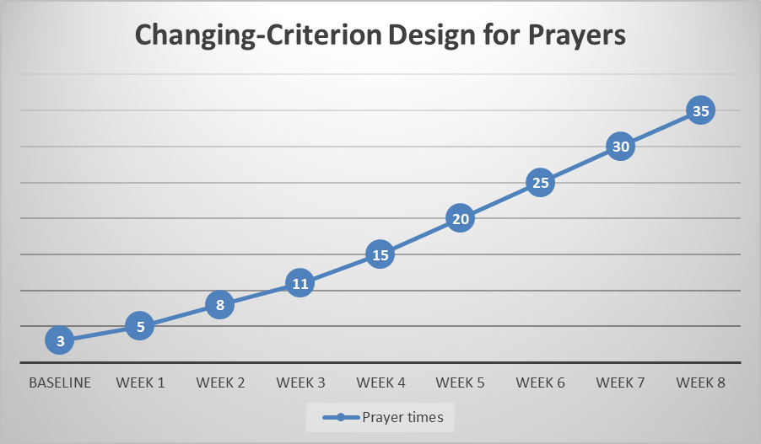
Hypothetical graph
Figure 1: Prayer times during the program implementation. 8 sub-phases are presented during the intervention using the changing-criterion design.

Slide 15
Figure 2: Implementation of changing-criterion design. Upward slope indicates success of intervention.

Slide 16
Evaluation of the intervention
Visual inspection
Looking at the trends in the graph reveal that all in all the intervention is successful. Although I have plateaued for this previous week, I am still engaging in prayer A LOT more than I was during baseline.
As days progresses, the criteria (the horizontal dotted line) moves up and the data points goes upwards as well.
In detail, the baseline data (phase A) revealed that I rarely engaged in the prayer behavior (3 times for 7 days). The first intervention phase (b1), therefore, started with a smaller criteria of meeting 5 prayers (which I reached) then the criteria gradually move up to 8 prayers (b₂), 11 prayers (b₃), 15 prayers (b4).
Still have 6 more weeks remaining due to the fact that this is a very gradual increase.

Slide 17
Evaluation of the intervention
Numerous studies have shown a positive correlation between mental well-being, which can come from positive religiosity and spiritual practice and low levels of stress/anxiety/depression.
It all begins in increasing the target behavior
Very important change: Applying behavioral therapy to help spiritual communities to engage more in their respective practices.
Generalizable: A Buddhist who wants to meditate more but is finding it hard to do so or a Christian who wants to increase the length of time they visit their local church.

