Slide 1
Classroom Management

Slide 2
School Psychology
Integration of psychological principles in helping students achieve academically, emotionally and socially.
How to use behaviorism to structure a classroom so that it is the most conducive towards learning?
Antecedents | Behavior | Consequences
Classroom organization (seating, layout, etc.) | Clear guidelines (demonstrating behavior) | Tied into the point system?
Use of visual supports (posters, cues, etc.) | Repeated Review | ’Punishment trap’
Behavioral momentum | Student Buy-in & motivation | Reinforcement pairing
Increasing student choice

Slide 3
Systems theory
A student’s framework is complex and ever-changing.
Multiple ‘layers’ we can change to effect the student.
Microsystem – Teachers, parents, peers, subjects, technology, afterschool activities.
Exosystem- ‘culture’ of the school; how departmental structure effects education and atmosphere.
Mesosytem – Interaction between the two.

Slide 4
Behavior in classrooms
Students spend majority of time in classrooms.
Basis for implementing change in behavior is well-established in science:
Behavior is learned.
Behavior can be changed.
Lasting behavioral change is more likely with positive, rather than punishing techniques.
Remaining engaged in instruction is essential to academic/social success.

Slide 5
The key
Behavior is functionally related to the teaching environment!
Behavior = what the student “does”
Teaching environment = all that happens before, during, and after the student’s behavior.
Also 99% of off-task behaviors include: talking out of turn, clowning, daydreaming, moving around without permission
Only a smaller fraction make-up antisocial, dangerous behaviors.

Slide 6
STOIC
Structure for success
Identify any changes in physical arrangements, procedures or supervision patterns that may have a positive effect on behavior.
Teach expectations
Teach students to function successfully; goal discussion, role modeling, daily rehearsal, etc.
Observe and monitor
Collecting data to determine progress across time.
Interact positively
Providing frequent positive feedback on behavioral and academic efforts.
Correct misbehavior fluently
Avoid power struggles that distract from instructional activity.

Slide 7
CHAMPS
CHAMPS worksheet for all the activities which happen throughout the day:
Counseling sessions
Zumba
Nutrition classes
Walking in hallway
First task: CHAMPs for all BOUNCE activities (have to establish clear guidelines)

Slide 8
Antecedents
Classroom lay-out; can students get up to do something without distracting others?
Classroom organization; materials ready, students engaged, jar is visible and repeated review (at beginning of each hour).
Posters which illustrate rules, points to be gained and ‘good behavior’

Slide 9
Observe student behavior
CHAMPs Versus Daily Reality Rating Scale.
Help give you some indication of whether classroom expectations are working!
Write each activity on the ‘Activity’ line and before each activity, review your CHAMPs expectations (with students if necessary), then immediately after completion; see how students met expectations.
Misbehavior Recording Sheet
Explain to students that for the entire day (or week) you are recording any time you have to speak to the class about inappropriate behavior.
Build your own coding system
O = off task
T = talking
A = arguing
D = disrupting class
S = out of seat at wrong time

Slide 10
Classroom expectations
Do students have problems with certain classroom procedures?
Clear guidelines in front of the classroom which demonstrate appropriate behavior.
Taking pictures of students behaving appropriately!
Re-teaching throughout the program; be preventative!
When you see that behavior is starting to deteriorate, do a role-modeling session!

Slide 11
Structure
Greet students as they enter the classroom; make them feel welcome and invited.
Opening activities should keep students actively engaged.
First session sets the tone – establish rules, how to earn points, ‘we are all in this together’, encourage participation so we all win ☺
Leaders and co-leaders should work together.
Teacher experience?
Strategies that have worked for you?
Other ‘systems-level’ changes for better compliance, motivation, etc.

Slide 12
Good behavior game
Evidence-based school intervention for promoting prosocial behaviors.
Pairing students – older boys with younger boys (same with girls) to facilitate mentorship & responsibility.
“What advice would you give to your 9-year old self?”
“What should I look forward to when I am in Junior High school?”
“What are your favorite things to do? Favorite video games?”
“What should our team name be?”
Create questions for students, rules for game and what students can win on single paper.
Demonstrate scenarios, role-model what is to be earned, have students answer and role-model (enhances buy-in)

Slide 13
Positive behaviors & Point system
Create a Positive Behavioral Chart system that ties in the CHAMPs guidelines with clear and demonstrative rules which students can redeem (what do the students like?)
Classroom contingency – All students work together collectively towards reinforcers
Group contingency – Paired students work in teams towards reinforcers
Individual contingency – Each student works independently
What we need: Bright & colorful posters, role-modeling sessions, reinforcements (i.e., how many points does student need?), consequences (what warrants a time-out?), visual behavioral chart, ice-breaker session and establishing rapport questions

Slide 14
Marble jar reward system
Small reinforcements - ‘if we reach this line for the day, everyone gets Hershey kisses or M&Ms or Snickers (optional), if we reach the 2nd line, you will get candy and a note home, 3rd line will get both and raffle for ‘big prize’.
Larger reinforcements - ’We have to reach the 3rd line (fill up the jar) as a group 6x to be eligible for the big prize.
Free movie tickets, raffle for $100 gift card, comic books, etc.
ALWAYS match behaviors with system

Slide 15
Creating behavior categories
Behavior Requiring Information | Behavior to Ignore | Behaviors Requiring In-Class Consequences | Behavior Requiring Out-of-Class Consequences
Teasing Off-task behavior Bad habits Sarcasm | Blurting out answers Smart comments Minor disruptions (chair noise, brief pencil tapping) Asking silly questions Tattling | Pushing, poking, minor hitting Disruptive behavior (pounding on the desk, shouting) Refusal to follow directions | Severe intrusion Insubordination to teacher

Slide 16
Which consequences?
Behavior Requiring Consequences | Selected Consequences
Pushing, poking, minor hitting Disruptive behavior (pounding on the desk, shouting) Refusal to follow directions Insubordination to teacher | One minute per infraction off recess Office referral/parental contact Time owed from recess and/or after school until compliance Five-minute time-out (away from class) Behavioral Improvement Form/parental contact Written apology

Slide 17
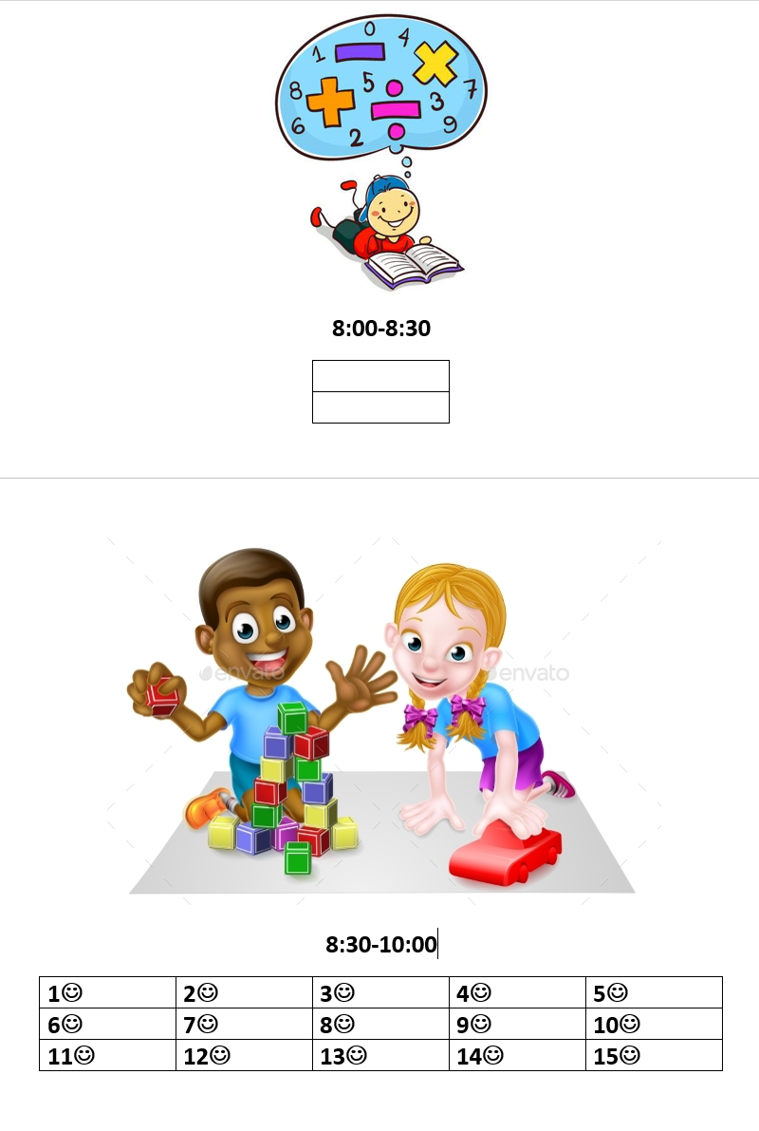
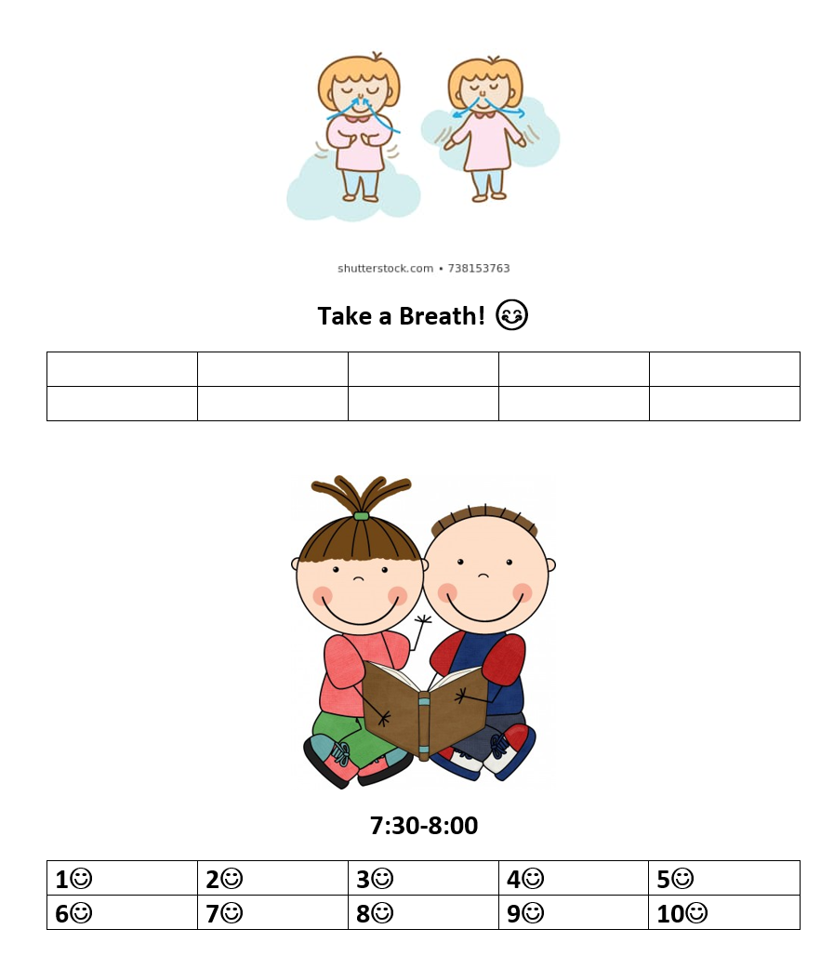
Daily Behavioral Chart

Slide 18
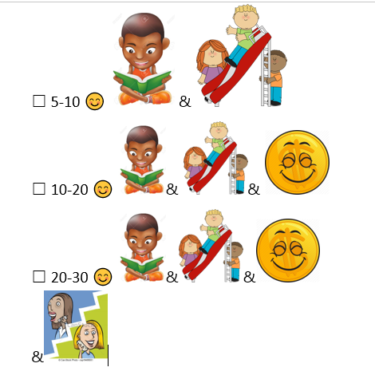
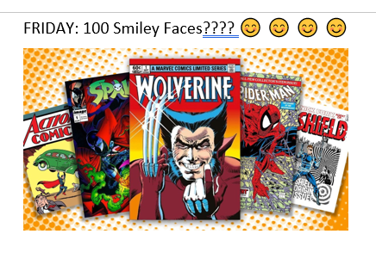

Slide 19
Ratio of interactions
One of the most powerful behavior management strategies.
Plan on interacting at least 3x more often with each student when they are behaving appropriately, than when they are misbehaving.
Ratio of Interactions Form and Behavior Improvement Form.

Slide 20
Different classroom-based consequences
Response Cost – Point system
Each student begins with 20 points; every time the student misbehaves, deduct a point. The points are allotted at the end towards some final goal (pizza party, pajama party, movie day).
Family cooperation – points can be taken home and traded in for video game time/YouTube time.

Slide 21
Interact positively with students
Showing an interest in who students are:
Greeting students as they arrive
Showing an interest in students work
Inviting students to ask for assistance
Having a conversation with class, as time permits
Making a special effort to greet or talk to any student who you’ve had a recent negative interaction with.
Providing non-embarrassing positive feedback:
Feedback should be accurate.
Feedback should be specific and descriptive.
Feedback should be contingent.
Feedback should be age appropriate.
Feedback should fit your style.

Slide 22
General Rules
Review BOUNCE guidelines – Can these ‘general’ rules be further broken down into game rules?
Review with children throughout the sessions – Reinforcement conditioning
“We are about to head to the gym, can someone tell me what you need to do to earn a sticker?”
Consistency is key – System will break down if students feel it is biased or unfair.
ALL teams that walked safely to the gym have earned a sticker, they have to visually see the sticker being placed or place it themselves.
Promote positive behaviors, rather than negative behaviors (3;1 ratio interaction on positive behaviors).

